Slide 1
Video Compression—From Concepts to the H.264/AVC Standard
Author: Thomas Wiegand and Gary J. Sullivan
Presenter: Zhao Fu

Slide 2
Outline
Background
Coding Design Problem Definition
Video Coding Basics
Video Transmission
Video Coding Standard
H.264/AVC Video Coding Standard
Conclusion

Slide 3

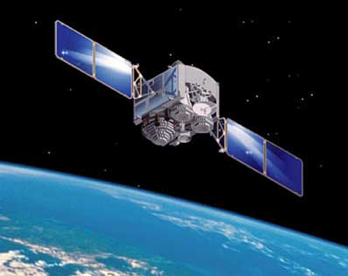

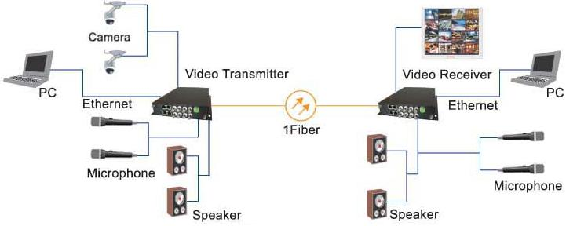

Background
Fig.1. Applications of digital video compression

Slide 4
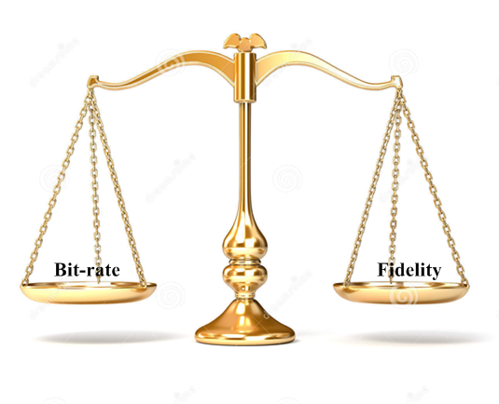
Coding Design Problem Definition
Video codec system
Fig.2. Tradeoff between bit-rate and fidelity

Slide 5
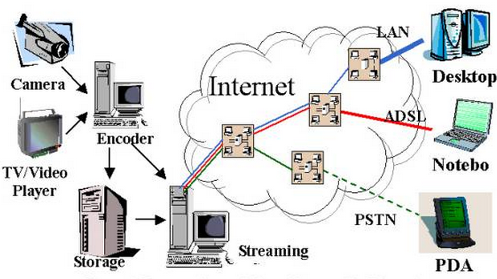
Coding Design Problem Definition
Video transmission system
Fig.3. Video transmission system

Slide 6
Coding Design Problem Definition
Problem Definition
Given a maximum allowed delay and a maximum allowed system complexity, achieve an optimal tradeoff between bit rate and distortion for the range of network environments envisioned in the scope of the applications.

Slide 7
Video Coding Basics
Video Components
  Video coding often uses a color representation having three components called Y, Cb, and Cr.
  Y is Called luma component, represents brightness;
  Cb is Called chroma component, represents the extent to which the color deviates from gray toward blue;
  Cr also Called chroma component, represents the extent to which the color deviates from gray toward red.

Slide 8

Video Coding Basics
Format
Top field contains the even-numbered rows and the bottom field contains the odd-numbered rows of a frame.
If the two fields of a frame are captured at different time instants, the frame is referred to as an interlaced frame, and otherwise it is referred to as a progressive frame.
Top field
Bottom field

Slide 9
Video Coding Basics
Techniques for digital compression
  Prediction
  A process by which a set of prediction values is created that is used to predict the values of the input samples.
  Transformation
  A process (also referred to as sub-band decomposition) that is closely related to prediction, consisting of forming a new set of samples from a combination of input samples, often using a linear combination.
  Quantization
  A process by which the precision used for the representation of a sample value (or a group of sample values) is reduced in order to reduce the amount of data needed to encode the representation.
  Entropy Coding
  A process by which discrete-valued source symbols are represented in a manner that takes advantage of the relative probabilities of the various possible values of each source symbol.

Slide 10
Video Coding Basics
Techniques for video compression
  Intra coding
  Picture is coded without referring to other pictures in a video sequence.
  Inter coding
  Sending only the changes in the video scene rather than coding all regions repeatedly, also can be called conditional replenishment
  Hybrid codes
  Construction as a hybrid of two redundancy reduction techniques—using both prediction and transformation.
  Motion-compensated prediction (MCP)
  Predicting an area of the current picture from a region of the previous picture that is displaced by a few samples in spatial location.

Slide 11
Video Coding Basics
Primary steps forward MCP to H.264/AVC standard
  Fractional-sample-accurate MCP
  MVs over picture boundaries
  Bipredictive MCP
  Variable block size MCP
  Multipicture MCP
  Multihypothesis and weighted MCP

Slide 12
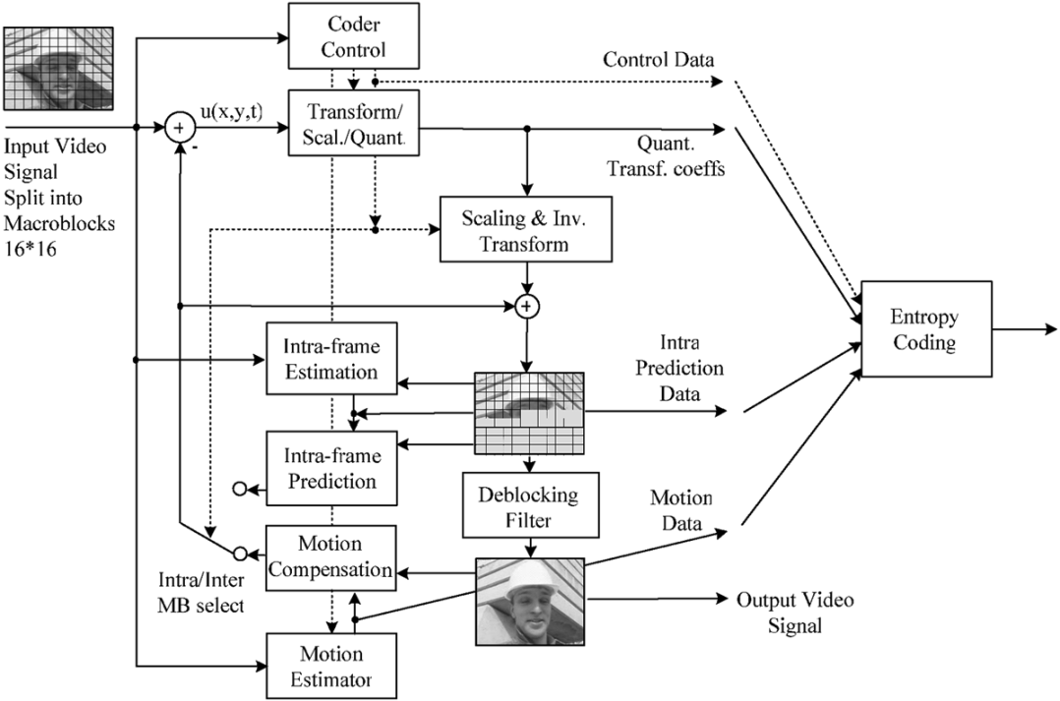
Video Coding Basics
Fig. 4. Hybrid video encoder (especially for H.264/AVC)

Slide 13
Video Transmission
Video transmission over error-prone channels
  Traditional techniques
    Forward error correction(FEC)
    Automatic repeat request(ARQ)
    Mix FEC and ARQ
  Weaknesses
    Increased delay
    Reduced throughput

Slide 14
Video Transmission
Proposed transmission system
  Separating more important data (such as header information, prediction modes, MVs, and Intra data) from less important data (such as the fine details of the Inter prediction residual representation) in the bitstream so that the more important data can still be decoded when some of the less important data has been lost. Providing greater protection against losses of the more important parts of the data can also be beneficial.

Slide 15
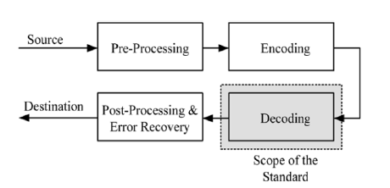
Video Coding Standard
Typical video coding standard
Fig. 5. Scope of video coding standardization.

Slide 16
H.264/AVC Video Coding Standard
A H.264/AVC Network Abstraction Layer(NAL)
  NAL units
  There are two classes of NAL units, called VCL and non-VCL NAL units. NAL units represents the values of the samples in the video pictures, and the non-VCL NAL units contain all other related information. A unit is a packet that contains a header and payload data.
  Parameter sets
  Sequence parameter sets, which apply to a series of consecutive coded video pictures;
  Picture parameter sets, which apply to the decoding of one or more individual pictures.
  Access units
  The set of VCL and non-VCL NAL units that is associated with a single decoded picture is referred to as an access unit.

Slide 17
H.264/AVC Video Coding Standard
B H.264/AVC Video Coding Layer(VCL)
  1) Macroblocks, Slices, and Slice Groups;
  2) Slice Types;
  I slice, P slice, B slice, SP slice and Si slice
  3) Intra-Picture Prediction;
  4) Inter-Picture Prediction:
    Inter-Picture Prediction in P Slices;
    Inter-Picture Prediction in B Slices;
    Weighted Prediction in P and B Slices.
  5) Transform, Scaling, and Quantization.

Slide 18
H.264/AVC Video Coding Standard
B H.264/AVC Video Coding Layer(VCL) Improvements
  6) Entropy Coding;
  7) In-Loop Deblocking Filter;
  8) Adaptive Frame/Field Coding Operation;
  9) Hypothetical Reference Decoder:
  10) Profiles and Levels.

Slide 19
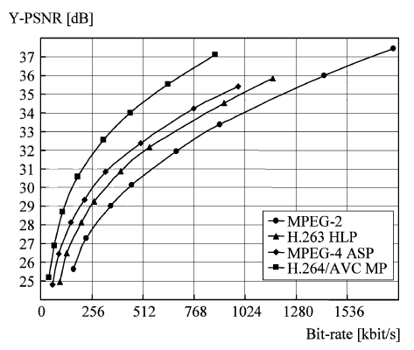
H.264/AVC Video Coding Standard
C Performance Comparisons
The measure of fidelity is luma peak
signal-to-noise ratio (PSNR), which is the
most widely used such objective video
quality measure,
where MSE is the mean squared error between the original and the corresponding decoding sample values.
Fig. 6. PSNR-rate curves for the test sequence “Tempete” in video streaming applications.

Slide 20
Conclusion
Based on conventional block based motion-compensated hybrid video coding concepts, with some important differences relative to prior standards, which include:
• enhanced motion prediction capability;
• use of a small block-size exact-match transform;
• adaptive in-loop deblocking filter;
• enhanced entropy coding methods.
When used well together, H.264/AVC provide approximately a 50% bit rate savings for equivalent perceptual quality relative to the performance of prior standards.

