Slide 1
A Model of Saliency-Based Visual Attention for Rapid Scene Analysis
By: Laurent Itti, Christof Koch, and Ernst Niebur
IEEE TRANSACTIONS, NOVEMBER 1998
Presenter: Vahid Vahidi
Fall 2015

Slide 2
Outline
Definition and the goal of this paper
Method
  Linear filtering
  Center surround differences and normalization
  Across scale combinations and normalization
  Linear combination and Winner-take-all
Simulation results
  Comparison with Spatial Frequency Content Models
  Comparing white noise with colored noise
Strengths and Limitations
Summary

Slide 3
Definition and the goal of this paper
Definition
Which part of the image attracts more attention?
Goal
Simulation of what is going on in our brain

Slide 4
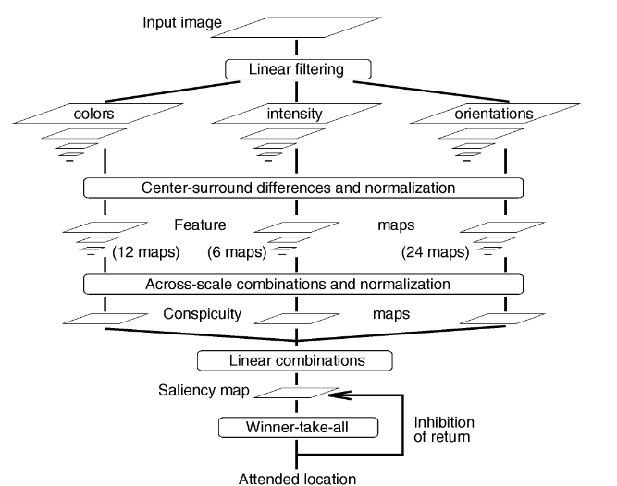
Method

Slide 5
Linear filtering
Four broadly-tuned color channels are created:
R = r - (g + b)/2 for red, G = g - (r + b)/2 for green, B = b - (r + g)/2
for blue, and Y = (r + g)/2 - |r - g|/2 - b for yellow
With r, g, and b being the red, green, and blue channels of the input image, an intensity image I is obtained as I=(r+g+b)/3.
Nine spatial scales are created using dyadic Gaussian pyramids.
Low-pass filter and subsample the input image would be performed.
1:1 (scale zero) to 1:256 (scale eight) in eight octaves.

Slide 6
Center surround differences and normalization
Center surround differences
Compute center-surround differences to determine contrast, by taking the difference between a fine (center) and a coarse scale (surround) for a given feature. This operation across spatial scales is done by interpolation to the fine scale and then point-by-point subtraction.

Slide 7
Normalization
Map normalization operator:
  Promotes maps in which a small number of strong peaks of activity is present
  Suppressing maps which contain numerous comparable peak responses.

Slide 8
Across scale combinations and normalization
The feature maps are combined into three conspicuity maps at the scale 4. This is obtained through across-scale addition by reducing each map to scale 4 and point-by-point addition.

Slide 9
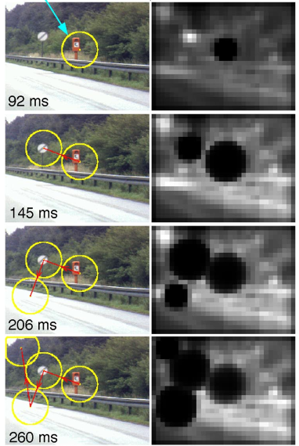

  Linear combination and Winner-take-all
Linear combination
saliency map would be achieved
Winner-take-all
  Models the SM as a 2D layer of leaky integrate-and-fire neurons at scale four.
  These model neurons consist of a single capacitance which integrates the charge
  When the threshold is reached, a prototypical spike is generated, and the capacitive charge is shunted to zero
  All WTA neurons also evolve independently of each other, until one (the “winner”) first reaches threshold and fires.

Slide 10
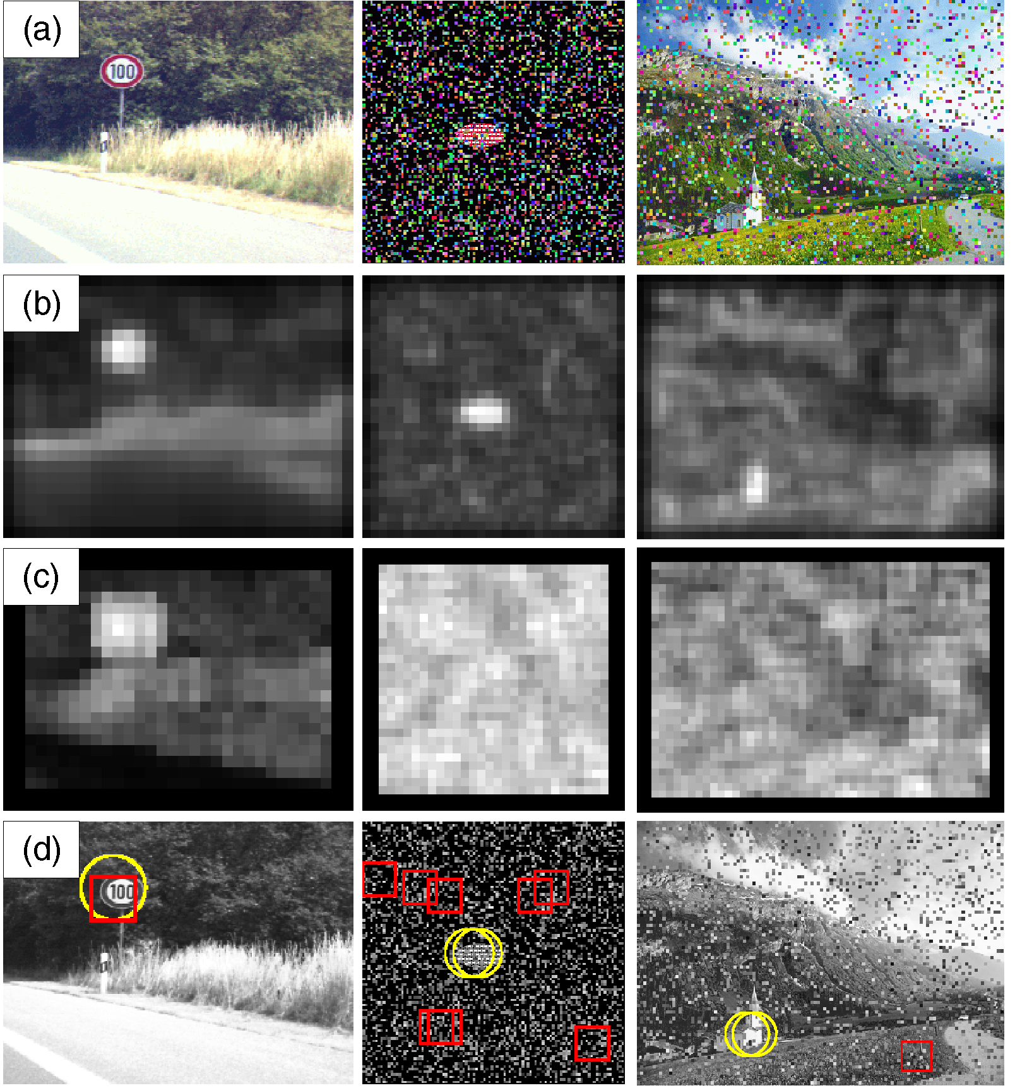
Comparison with Spatial Frequency Content Models
SFC
  At a given image location, a 16 ´ 16 image patch is extracted from each I(2), R(2), G(2), B(2), and Y(2) map, and 2D Fast Fourier Transforms (FFTs) are applied to the patches.
  The SFC measure is the average of the numbers of non-negligible coefficients in the five corresponding patches.

Slide 11
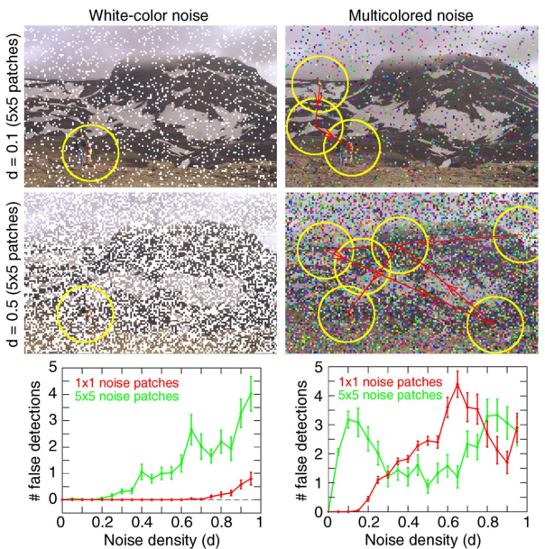
Comparing white noise with colored noise

Slide 12
Strengths and Limitations
Strength
  In this approach, architecture and components mimic the properties of primate early vision
  It is capable of strong performance with complex natural scenes (Ex. it quickly detected salient traffic signs)
  The major strength of this approach lies in the massively parallel implementation
Limitations
  it will fail at detecting unimplemented feature types (e.g., T junctions or line terminators)
  Without modifying the preattentive feature-extraction stages, our model cannot detect conjunctions of features.

Slide 13
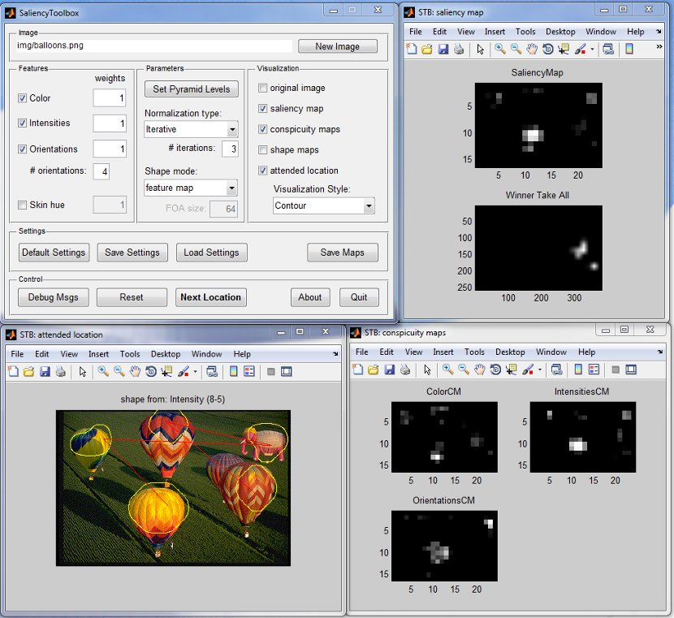
MATLAB
MATLAB has saliency Toolbox

Slide 14
Summary
I have reviewed the saliency paper
Definition of saliency
Method
  Based on intensity, color and orientation, 42 center surround maps would be achieved.
  Normalized maps are combined at scale 4
  Saliency map is achieved by the combination of normalized maps of intensity, color and orientation
  Winner-take-all procedure finds salient areas in the decreasing order
Results
  Saliency performs better than SFC in presence of noise
  Saliency performs better in the presence of white noise in comparison to the presence of colored noise

Slide 15
Thanks for your attention

