Slide 1
Object Detection with Discriminatively Trained Part Based Models
Pedro F. Felzenszwalb, Ross B. Girshick, David McAllester, and Deva Ramanan

Slide 2
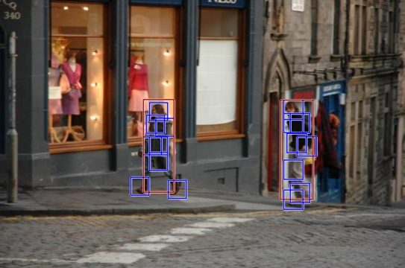
Motivation
Problem: Detecting and localizing generic objects from categories (e.g. people, cars, etc.) in static images.
Issues to overcome:
  Changes in illumination or viewpoint
  Non-rigid deformations, e.g. pose
  Intraclass variability, e.g. types of cars

Slide 3
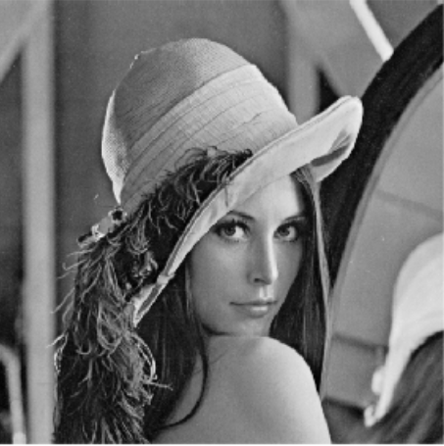
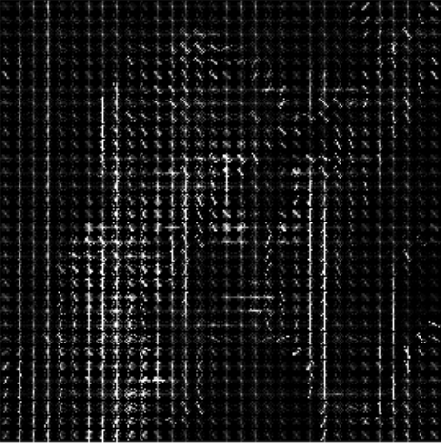
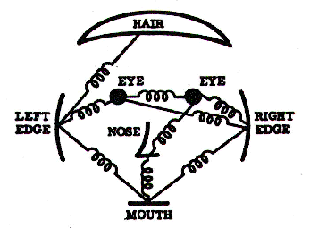
Previous Works
Dalal & Triggs ‘05
Fischler & Elschlager ‘73
Felzenszwalb & Huttenlocher ‘00
Histogram of Oriented Gradients (HOG)
Support Vector Machines (SVM) Training
Sliding window detection
Pictorial structures
Weak appearance models
Non-Discriminative training
Original Image
Histogram of Oriented Gradients
Pictorial Structures Model of a Face

Slide 4
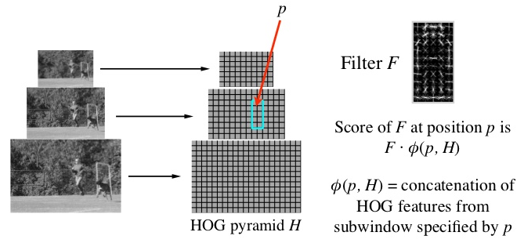
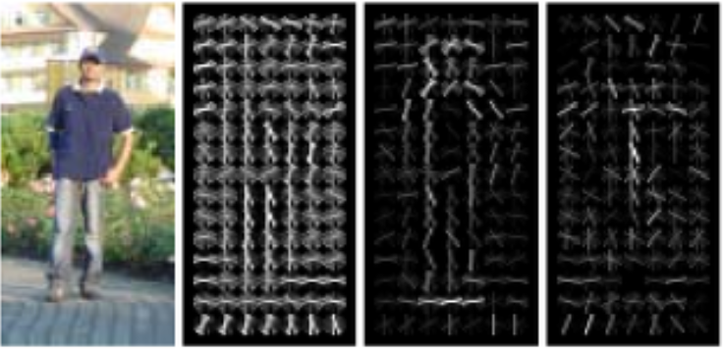
Object Detection with Histogram of Oriented gradients
Combine HOG and Linear SVM
Detects objects using weighted HOG filters
Inspect both positive and negative weighted results
Human or not?
Original Image
Extracted Gradient
Positive Weights
Negative Weights

Slide 5
MODELS
Deformable Part Models (DPM)
Matching
Mixture Models

Slide 6
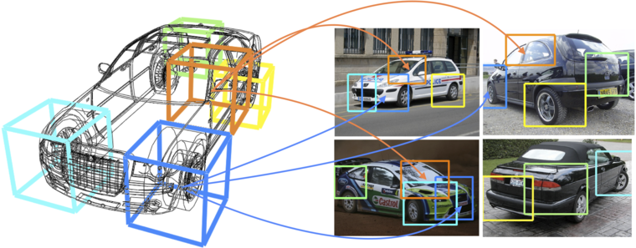
Deformable Part Models (DPM)
Represent object by several parts
Model is deformable, i.e. parts can move independently of each other
Parts are “punished” for being far away from their origin

Slide 7
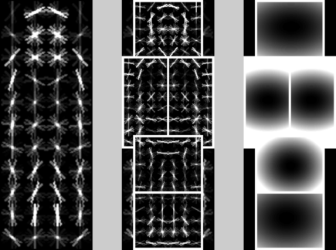
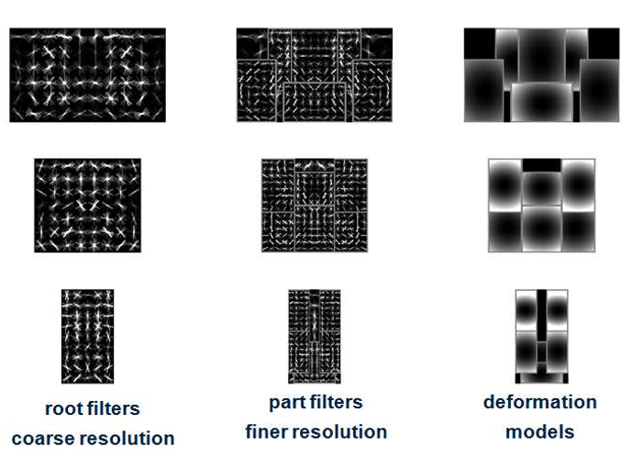
Deformable Part Models (DPM)
Model has a root filter F_{O} and n part models represented by (F_{i},v_{i},d_{i})
  F_{i} is the i-th part filter
  v_{i} is the is the origin of the i-th part relative to the root
  d_{i} is the deformation parameter
Coarse Filter
High-res Part Filter
Deformation models

Slide 8

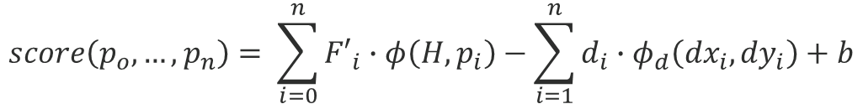

Deformable Part Models (DPM)
$$score\left(p_{o},…,p_{n}\right)= \sum_{i=0}^{n}{{F′}_{i}∙φ\left(H,p_{i}\right)−\sum_{i=1}^{n}{d_{i}∙φ_{d}\left({dx}_{i},{dy}_{i}\right)+b}}$$
Bias
Filters
Feature of subwindow at location p_{i}
Deformation Parameters
Displacement of part i
Score of hypothesis z…
Unknown…
Known…
$$score\left(z\right)=β∙ψ(H,z)$$
$$β=(F_{0},…,F_{n},d_{1},…,d_{n},b)$$
$$ψ\left(H,z\right)=(φ\left(H,p_{0}\right),…,ϕ\left(H,p_{n}\right),−φ\left({dx}_{1},{dy}_{1}\right),…,−φ\left({dx}_{n},{dy}_{n}\right),1)$$

Slide 9



Deformable Part Models (DPM)
Data term
Spatial info
$$score\left(p_{o},…,p_{n}\right)= \sum_{i=0}^{n}{{F′}_{i}∙φ\left(H,p_{i}\right)−\sum_{i=1}^{n}{d_{i}∙φ_{d}\left({dx}_{i},{dy}_{i}\right)+b}}$$
Bias
Filters
Feature of subwindow at location p_{i}
Deformation Parameters
Displacement of part i
Initial condition:
$$d_{i}=(0,0,1,1)$$
Displacement Function:
$$φ_{d}\left(dx,dy\right)=(dx,dy,{dx}^{2},{dy}^{2})$$

Slide 10
Matching
The overall score of a root location is computed according to the best possible placement of parts
  High scoring root locations define detections
  High scoring part roots define object hypothesis
$$score\left(p_{0}\right)=\max_{p_{1},…,p_{n}}{score(p_{0},…,p_{n})}$$

Slide 11
Matching

Slide 12
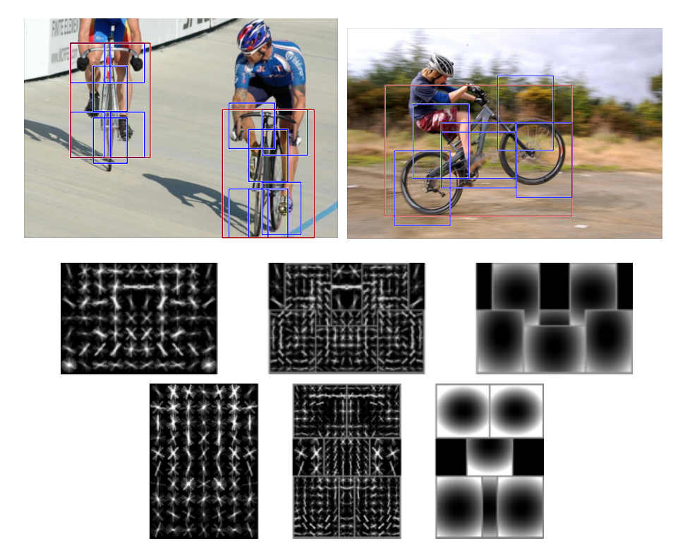
Mixture Models
Modelling for objects is done using multiple orientations
Models subject to translation and rotation around the axis perpendicular to the page

Slide 13
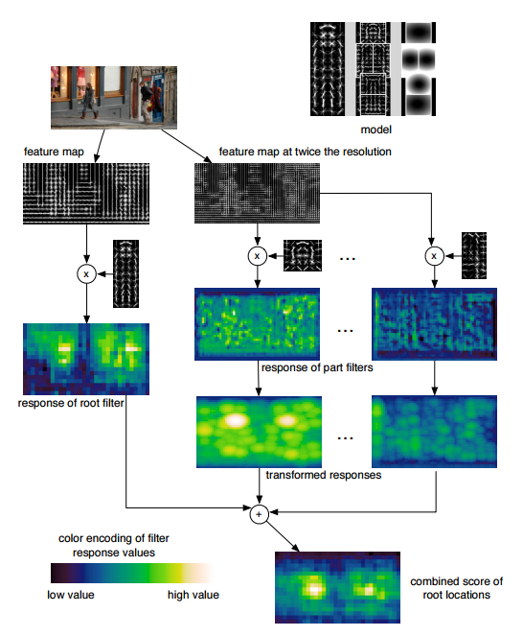
Mixture Models
Models are compared to source images in parallel
Scores of model and part filtering are combined for detection

Slide 14
Latent SVM
Add your first bullet point here
Add your second bullet point here
Add your third bullet point here

Slide 15
Training
Add your first bullet point here
Add your second bullet point here
Add your third bullet point here

Slide 16
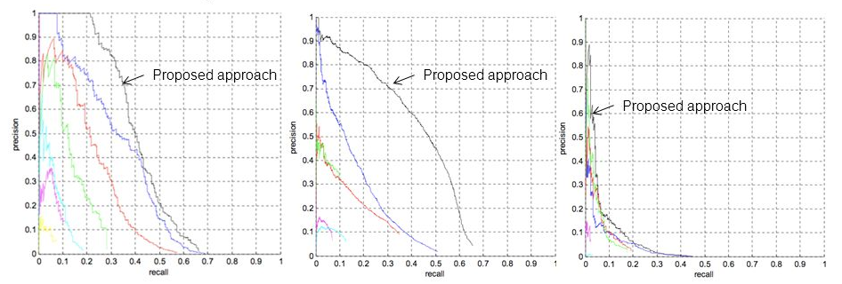
Results (PASCAL VOC 2008)
Seven total systems competed
DPM placed first in 7/20 categories

Slide 17
Title and content layout with SmartArt
Step 1 Title
Task description
Step 2 Title
Task description
Step 3 Title
Task description

Slide 18
Title and content layout with chart

