Slide 1
Vision-based 3d bicycle tracking using deformable part model and interacting multiple model filter
Presentation by Jonathan Kaan DeBoy
Paper by Hyunggi Cho, Paul E. Rybski and Wende Zhang

Slide 2
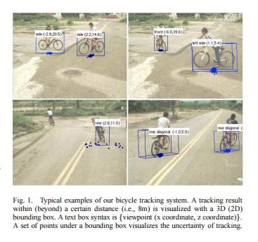
Motivation
Build understanding of surrounding
Detect vulnerable road users (VRU)
  Bicyclist
  Motor cyclists
  Pedestrians
Change appearances very drastically and a very short time
Currently
  LIDAR and RADAR
  This paper focuses vision implementation

Slide 3
Vision Based Detection
Higher resolution view of the world
Color, texture, shape, contours
Low cost
Processor intensive—complicated backgrounds to extract from
Error prone to lightening changes, object shape, etc.

Slide 4
Other Forms of Detection
Planar LIDAR
Low resolution RADAR
Only RCS/LCS is available
High cost
Easy on processing
Not as susceptible to noise

Slide 5
3 Major Contributions

Slide 6
1st – Model
Three-component bicycle model
Bicycle Kinematics have restrictive constraints on movement
  Unlike pedestrians
Two motion models
  IMM estimator
  Extended Kalman Filter
Position and orientation in vehicle coordinates

Slide 7
2nd – Tracking
Extension of single bicycle tracking
Rao-Blackwellized Particle Filter
  Particle filter for data association
IMM for each bicycle tracking

Slide 8
3rd – Bicycle Dataset
First public domain bicycle dataset
Available for anyone to conduct bicycle tracking research

Slide 9
Pedestrian Detection

Slide 10
Single Template
Originally showed better performance
Capture whole human body with detection window
  Haar wavelet with polynomial SVM
Dense Histogram of Oriented Gradient (HOG) then linear SVM

Slide 11
Part-Based
Began to look more promising
  Flexible and rich models
Captures the pattern of each part—handles various appearances
Divide body into 4 parts: head, legs, left arm, right arm
Polynomial SVM fed into a classifier
Scale Invariant Feature Transform (SIFT)

Slide 12
Pedestrian Tracking
Statistical Probabilistic Methods
  Extended Kalman Filter
  Particle Filter
  Alpha Beta Filter
Constant velocity

Slide 13
Bicycle Detection
Object detection and tracking by detection
  Run every frame
Detector Virtual Sensor
  2D bounding boxes
Different classes of bicycles
  Road, mountain, etc.

Slide 14
Deformable Parts Model

Slide 15
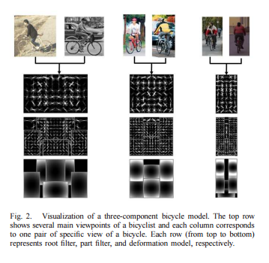
Deformable Part Representation
Star structured part-based model with:
Root filter
  Capturing overall shape of an object (2nd row)
Part filters
  Capture the appearance of each part of an object (3rd row)
Deformation parameters
  Deviation from ideal location (4th row)
Score = Root filter score + part filter score (from best possible placement) – deformation cost

Slide 16
Efficient Matching Process
Dynamic programing
Generalized distance transforms
Huge optimization model for matching
Important to use fast method for a detection task

Slide 17

Latent SVM Training Process
Train a mixture of star models from bounding box ground truth
Optimization task with two sets of variables
  Beta is vector of model parameters
  Z’s are latent values
  Phi(x,z) is feature vector
  Star model example
    beta is root (+) parts (+) deformation costs
    Z is specification of object configuration
    Phi(x,z) is concatenation of sub windows

Slide 18

Bicycle Detector as a Virtual Sensor
Monocular video camera – sequence of images
Generates set of bounding boxes for potential bicycles
Essentially a sequence of measurements at time step k
Measurement is fed to Kalman filter
  bi is: y coordinates of top (t) and bottom (d) border of box, x coordinates of left (l) and right (r) borders, and an index of its view (v)

Slide 19
Number of Viewpoints
Our camera is moving, detector must account
Tradeoff between increasing number of models and reducing time complexity.
8 view-based bicycle detector was used
Paired and trained by symmetric counterpart

Slide 20
Multiple Bicycle Tracking with IMM Algorithm and a Rao-Blackwellized Particle Filter
Bicycle detector is very processor demanding
Need reliable tracking algorithm that is certain of its uncertainty for tracking
→Extended Kalman Filter

Slide 21
Alpha-Beta Filter
Tracks based off incoming data and previous velocity
Velocity is updated based on a weighted sum
  Previous prediction (acquired from previous data points)
  Current data point
  Alpha and Beta are typically set weights

Slide 22
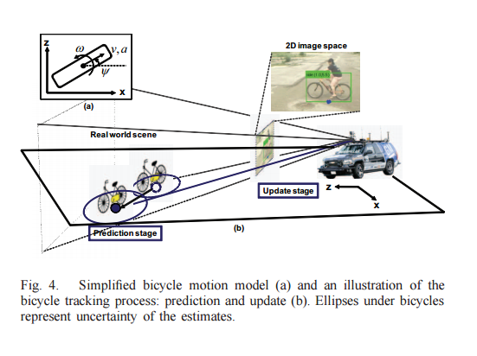
Extended Kalman Filter
Real motion modeled by simple motion models
Linearized nonlinear perspective projection (not extended)
Assume flat ground
Tracking:
  Predict
  Update

Slide 23
Bicycle Motion Model Set
Bicycles have unique kinematics
  Difficult to measure when the object is in a rough bounding box
Instead comprehensive experiment results lead to moving mass with constant velocity model
To improve performance,
  Add simplified versions of bicycle’s kinematics
Use a well-known IMM filter

Slide 24
Interactive Multiple Model (IMM) Filter
Multiple motion models representing dynamic behaviors
  Maneuvering
Several motion models ran in parallel
Estimates a state through weighted sum of several filter results

Slide 25

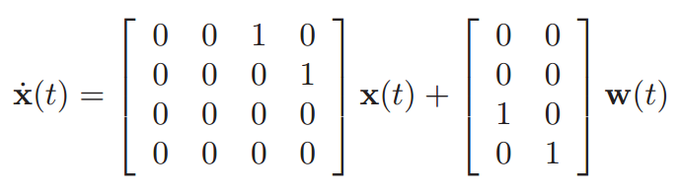

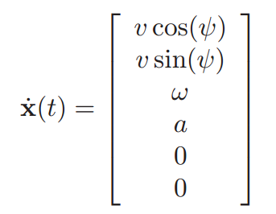
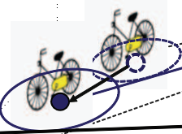
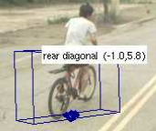
Model Set
Constant Velocity (CV)
Simplified Bicycle (SB)
Point model and 3D bounding box

Slide 26

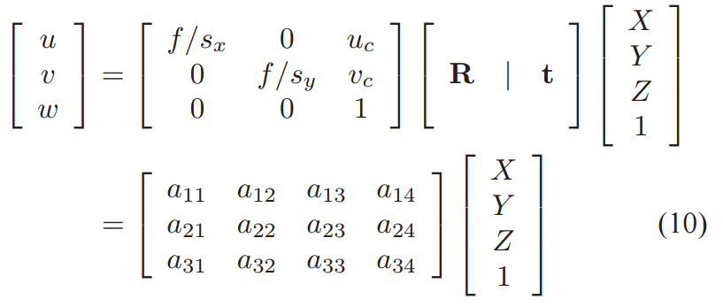
Bicycle Measurement Model
Need a way to map image space to vehicle coordinates (state space)
One representative point (middle of bottom line of 2D bounding box)

Slide 27
Extension to Multiple Bicycle Tracking

Slide 28
Rao-Blackwellized Particle Filter (RBPF)
Multiple measurements – no information on number of bicycles that exist
Break down huge state estimation into smaller problems
  Analytical solutions and particle filter solution
Rao-Blackwellized Monte Carlo Data Association RBMCDA algorithm
Bayesian factorization
Separate posterior into number of bicycles and a tracking problem

Slide 29
Experimental Results

Slide 30
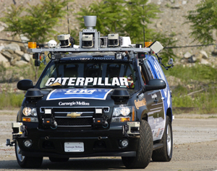
The Experiment
Boss
  DARPA Urban Challenge winner of 2007
8 view-based bicycle model
  Analyze the statistics of bicycle detection responses
Deformable Parts Model
https://www.cmu.edu/news/image-archive/Boss.jpg

Slide 31
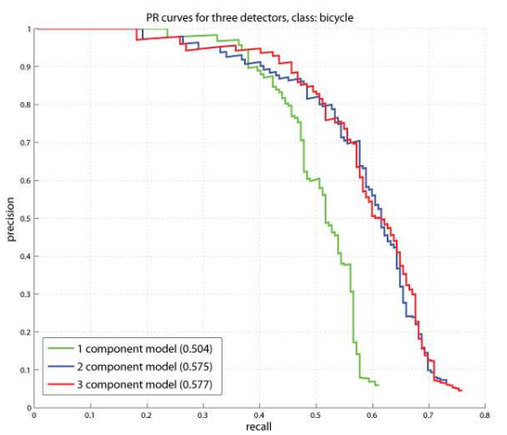
Detection Performance
Building bicycle model
  357 positive training samples
  3300 negative samples
Three component model
  8 viewpoints
    Frontal, rear, four diagonal, left, right
  Precision Recall (PR) Curve
    Documents search engine

Slide 32
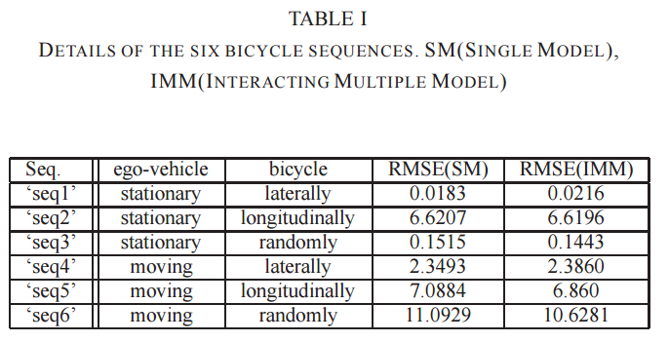
Tracking Performance
6 Video sequences
  3 Stationary vehicle, 3 moving
RMS error compare between CV and CV+SB in IMM filter

Slide 33
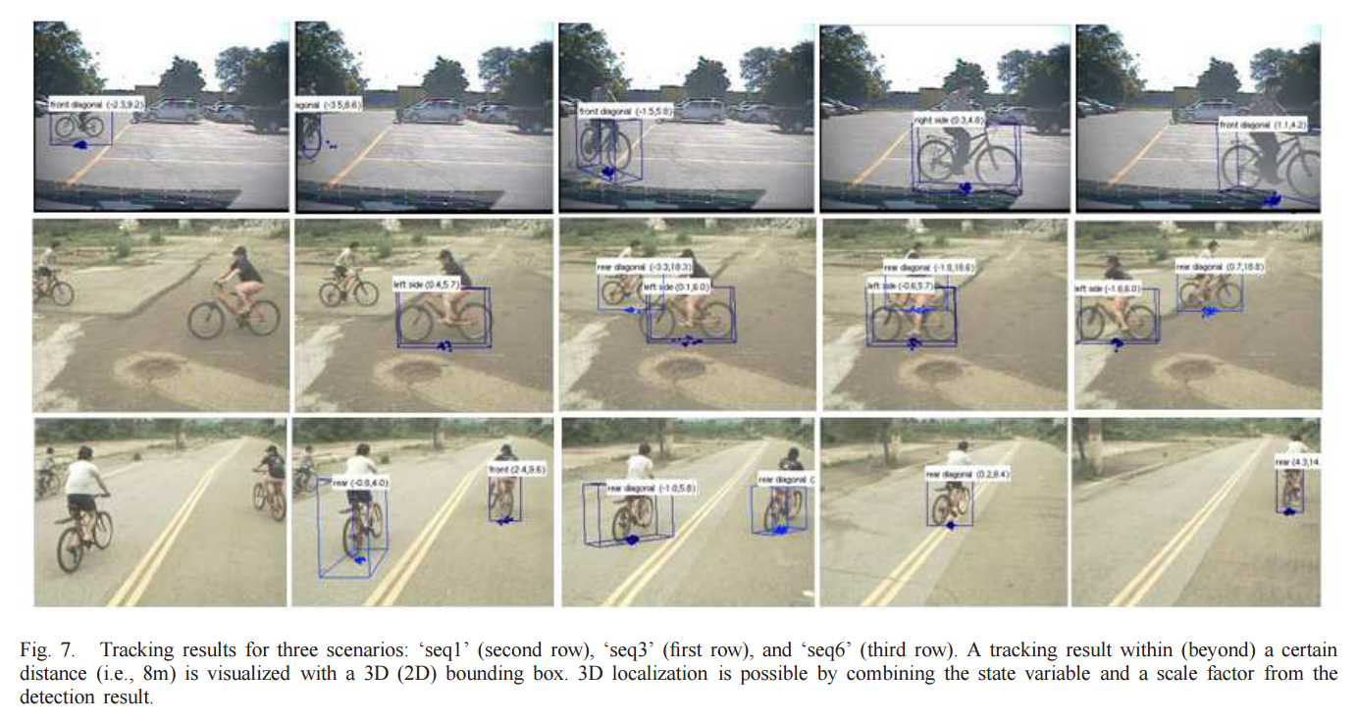

Slide 34
Conclusions and Future Work
Deformable Parts Based Model to detect bicycles
  3 Part Bicycle Model
Two motion models: CV and SB
  Sent to EKF to estimate position and velocity in vehicle coordinate system
IMM tracking algorithm
  Extended with Rao-Blackwellized Particle Filter for multiple bicycles tracks
Future
  New measurement mapping function to extract more info from 2D bounding box

