Slide 1
PRESENTED BY Yang Jiao
Timo Ahonen, Matti Pietikainen
Face Description with Local Binary Patterns: Application to Face Recognition
1/34

Slide 2
CONTENT
01
02
03
Background
Introduction
Methodology
04
05
06
Evaluation
Result
Conclusion & Review

Slide 3
Part1
Background

Slide 4
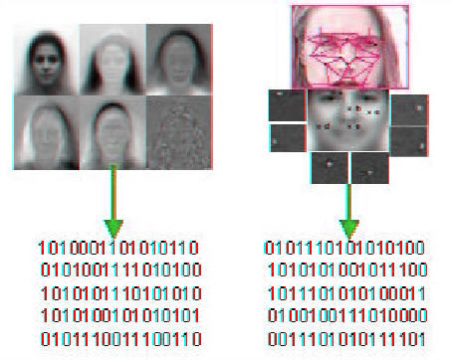
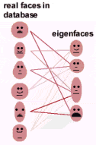
Background
EIGENFACE TECHNOLOGY
Linear Discriminant Analysis
Face image captured via camera and processed using an algorithm based on principle component analysis (PCA) which translates characteristics of a face into an uniquie set of numbers.
To identify a face, the program compares its Eigenface characteristics, which are encoded into numbers called a template, with those in the database, selecting the faces whose templates match the target most closely
4/34

Slide 5
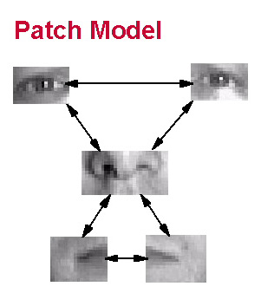
Background
LOCAL FEATURE ANALYSIS
Linear Discriminant Analysis
Local feature analysis considers individual features. These features are the building blocks from which all facial images can be constructed.
Local feature analysis selects features in each face that differ most from other faces such as, the nose, eyebrows, mouth and the areas where the curvature of the bones changes.
5/34

Slide 6
Background
Image with complex background
Poor lighting condition
Recognition accuracy
Problems
6/34

Slide 7
Background
Need a method that has robustness against variations on poses or illumination change.
Holistic texture descriptor tends to average the image area to against texture translation or rotation which loses the spatial relations
Motivations
7/34

Slide 8
Part2
Introduction

Slide 9
LBP
LBP operator
Extended LBP
Uniform patterns
The operator assigns a label to every pixel of an image by thresholding the 3x3 neighborhood of each pixel with the center pixel value and considering the result as a binary number.
Defining the local neighborhood as a set of sampling points evenly spaced on a circle centered at the pixel to be labeled allows any radius and number of sampling points. Notation (P, R) is used.
A local binary pattern is called
uniform if the binary pattern contains at most two bitwise transitions from 0 to 1 or 1 to 0 when the bit pattern is
considered circular.
Taken as threshold
9/34

Slide 10
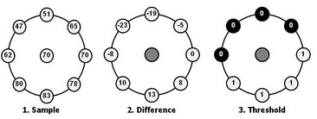
LBP
LBP operator
Extended LBP
Uniform patterns
The operator assigns a label to every pixel of an image by thresholding the 3x3 neighborhood of each pixel with the center pixel value and considering the result as a binary number.
Defining the local neighborhood as a set of sampling points evenly spaced on a circle centered at the pixel to be labeled allows any radius and number of sampling points. Notation (P, R) is used.
A local binary pattern is called
uniform if the binary pattern contains at most two bitwise transitions from 0 to 1 or 1 to 0 when the bit pattern is
considered circular.
p
R
Neighborhood number
10/34

Slide 11
LBP
LBP operator
Extended LBP
Uniform patterns
The operator assigns a label to every pixel of an image by thresholding the 3x3 neighborhood of each pixel with the center pixel value and considering the result as a binary number.
Defining the local neighborhood as a set of sampling points evenly spaced on a circle centered at the pixel to be labeled allows any radius and number of sampling points. Notation (P, R) is used.
A local binary pattern is called
uniform if the binary pattern contains at most two bitwise transitions from 0 to 1 or 1 to 0 when the bit pattern is
considered circular.
00000000 (0 transitions), 01110000 (2 transitions), 11001111 (2 transitions)
11001001 (4 transitions), 01010011 (6 transitions)
11/34

Slide 12
Part3
Methodology

Slide 13
Methodology
1. The facial image is divided into local regions
2. Texture descriptors are extracted from each region independently.
3. The descriptors are then concatenated to form a global description of the face.
4. Weighted distance measurement
13/34

Slide 14
Methodology
1. Dividing a facial image into rectangular regions
Circle?
Overlapping?
14/34

Slide 15
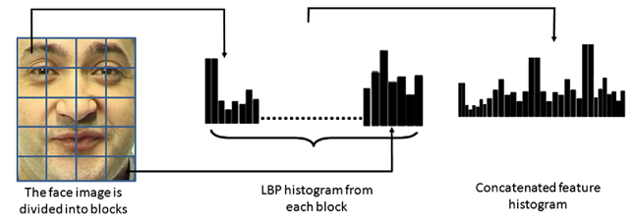
Methodology
1. Dividing a facial image into rectangular regions
2. Spatial enhanced histogram
Local pattern
global pattern
3 levels features:
Patterns on pixel-level
Patterns on small region
Holistic pattern
M
M*N
N
15/34

Slide 16
Methodology
1. Dividing a facial image into rectangular regions
2. Special enhanced histogram
3. Regions weighted
which x and ξ are the normalized enhanced histograms to be compared, indices i and j refer to ith bin in histogram corresponding to the jth local region and wj is the weight for region j
16/34

Slide 17
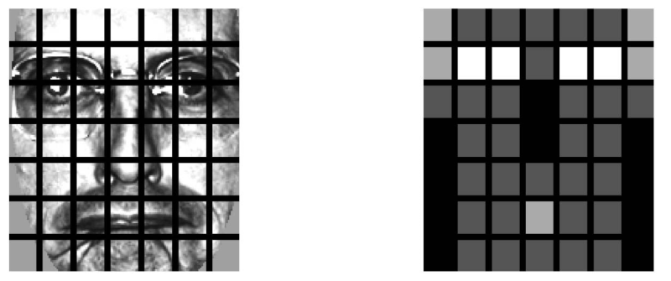
Methodology
1. Dividing a facial image into rectangular regions
2. Special enhanced histogram
3. Regions weighted
Black squares indicate weight 0.0, dark gray 1.0, light gray 2.0, and white 4.0
17/34

Slide 18
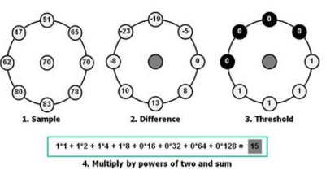
Methodology
1. Dividing a facial image into rectangular regions
2. Special enhanced histogram
3. Regions weighted
$${LBP}_{}^{u2} with notion(8,2)$$
∑
The result has the smallest distance
Weighted distance measure
Descriptor
18/34

Slide 19
Part4
Evaluation

Slide 20
Evaluation
1. The Coronado State University face identification evaluation system was used
2. The FERET data base was used
20/34

Slide 21
Evaluation
1. CSU FIES
The CSU Face Identification Evaluation System provides standard face recognition algorithms and standard statistical methods for comparing face recognition algorithms.
The system includes standardized image pre-processing software, fore distinct face recognition algorithms, analysis software to study algorithm performance, and Unix shell scripts to run standard experiments.
21/34

Slide 22
Evaluation
2. FERET database
The database consists of a total of 14,051 gray-scale images representing 1,199 individuals. The images contain variations in lighting, facial expressions, pose angle, etc.
22/34

Slide 23
Evaluation
3. Image groups setting
Fa: gallery set which contains all frontal images
Fb: alternative facial expression images than fa set (1195 images)
Fc: photos which were taken under different light conditions (194 images)
Dup I: images which were taken later (722 images)
Dup II: images which were taken at least one year later (234 images)
23/34

Slide 24
Evaluation
4. Comparison set
PCA: Principle Components Analysis
BIC: Bayesian Intrapersonal/Extrapersonal Classifier
EBGM: Elastic Bunch Graph Matching
24/34

Slide 25
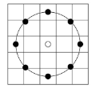
Evaluation
5. parameters set
Notation (P, R) is used and set as 8,2 (8 sample points and 2 pixels radius)
Facial area is cut into 18*21 pixels windows
Weight parameters is
25/34

Slide 26
Part5
Result

Slide 27
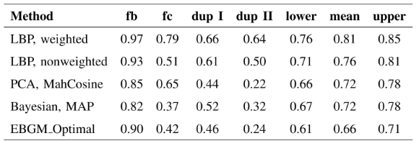
Result
1. Table
light
age
27/34

Slide 28
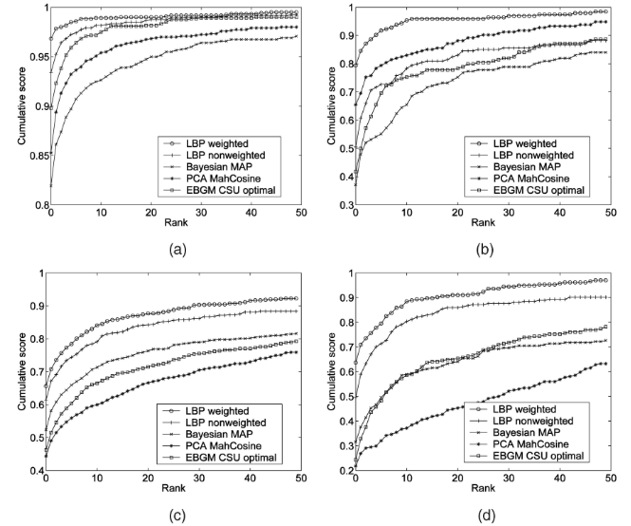
Result
2. Cumulative match curves
28/34

Slide 29
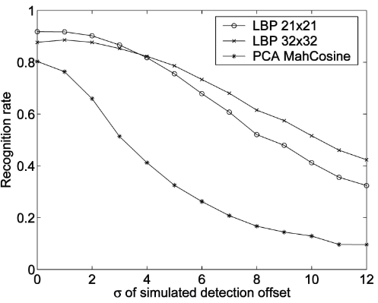
Result
3. Robustness of localization error
29/34

Slide 30
Part6
Conclusion & Review

Slide 31
Conclusion & Review
1. Dividing a facial image into rectangular regions
2. Special enhanced histogram
3. Regions weighted
$${LBP}_{}^{u2} with notion(8,2)$$
∑
The result has the smallest distance
Weighted distance measure
Descriptor
31/34

Slide 32
Conclusion & Review
LBP has robustness against variations on poses or illumination change.
Easily to implement
Good Accuracy
Advantages
32/34

Slide 33
Conclusion & Review
Long histograms can slow down the recognition speed
May miss the local structure due to ignoring the effect of the center pixel
Binary data produced are sensitive to noise
Disadvantages
33/34

Slide 34
PRESENTED BY Yang Jiao
THANKS
Face Description with Local Binary Patterns: Application to Face Recognition
34/34

