Slide 1
Mobile Robot Localization and Mapping with Uncertainty using Scale-Invariant Visual Landmarks
Paper – Stephen Se, David Lowe, Jim Little
Presentation – Nicholas Moya

Slide 2
Decoding the Title
Visual SLAM using SIFT features as landmarks
  SLAM: Simultaneous Localization and Mapping
  SIFT: Scale-Invariant Feature transform
The robot finds SIFT features in its environment, and uses them as landmarks to build a map and localize itself within that map.

Slide 3
Overview
Previous Work
SIFT
Estimating Motion
Results
Improvements
Conclusion

Slide 4
Previous Work

Slide 5
Previous Work
SLAM definition
  The process of simultaneously tracking the position of a mobile robot relative to its environment while building a map of the environment.
Problem
  Robot starts in unknown location, observes its landmarks, estimates location and landmark location, then builds a map of landmarks and uses them for localization.
Early Attempts were sensor-based:
  Sonar – Fast but crude
  Laser – Accurate but slow to respond
  Vision – Processor intensive but higher accuracy and resolution

Slide 6
Previous Work
Recent Attempts have been vision-based, but not without problems
  Monocular – Creates gaps in map for long term image sequences
  Could not run in real time
  Not computationally strong enough to be used in large environments
The approach in this paper uses high-level image features (corners) which are scale invariant and distinctive enough to allow for more efficient map creation algorithms.

Slide 7
New SLAM Algorithm
Identify SIFT landmarks
  Scale invariant feature transform
Match landmarks between frames from different cameras
  Use Trinocular stereo vision system
  Stereo means using more than more one viewpoint for vision
  3D position of landmarks
Match landmarks between past and future frames
3D map full of SIFT features that is constantly updated
  Adaptive to changing environments
Estimate motion, position
Localize itself within map

Slide 8
SIFT

Slide 9
SIFT
SIFT Definition
  A method of determining local features in images, specifically, features that are invariant to image translation, scaling, rotation, illumination changes, and affine projection.
Landmarks are determined by extracting SIFT features from each frame from the three images and stereo match them among the images.

Slide 10
Generating SIFT Features
2
DoG Image = Original Image - Smoothed Image
3
DoG image is resampled with 1.5 pixel spacing to produce next level in the pyramid
4
Repeated until the pyramid is complete
1
Smooth image with Gaussian Kernel (σ = $\sqrt{2}$)
Smooth image with Gaussian Kernel (σ = √2)
SIFT feature locations are determined by identifying repeatable points in a pyramid of scaled images
DoG: Difference of Gaussians
Features are identified by detecting maxima and minima in the DoG pyramid.

Slide 11
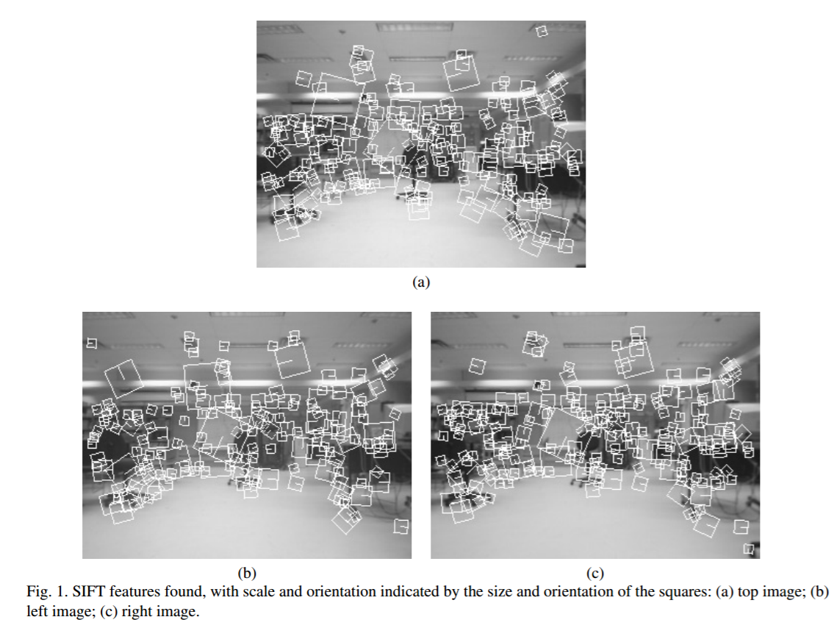

Slide 12
Matching using the Triclops system
Three cameras are arranged in an ‘L’ shape
SIFT features are matched by passing several constraints
  Vertically: within 1 pixel of each other
  Horizontally: within 20 pixels of each other
  Must be within 20° orientation
  Must be found one scale higher and/or lower than the other
The features that pass are kept as landmarks.
Using the (x,y,z) coordinates of the landmarks gives the position of the robot relative to its environment

Slide 13
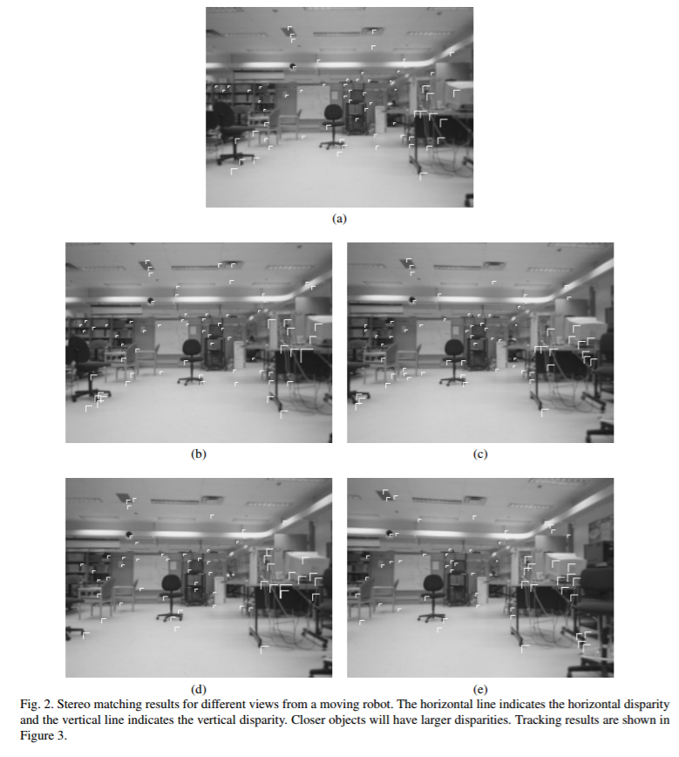

Slide 14
Ego-Motion Estimation

Slide 15
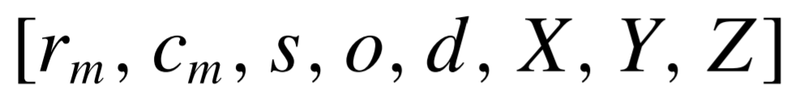
Ego-Motion Estimation
After SIFT stereo matching, some information for each SIFT feature
  (r_{m}, c_{m}) Measured image coordinates of the reference camera
  (s,o,d) Scale, Orientation, Disparity of the feature
    Disparity: Think of parallax
  (X,Y,Z) 3D coordinates of landmark relative to camera
Must match SIFT features between frames to estimate motion
But how to match SIFT features between frames?

Slide 16
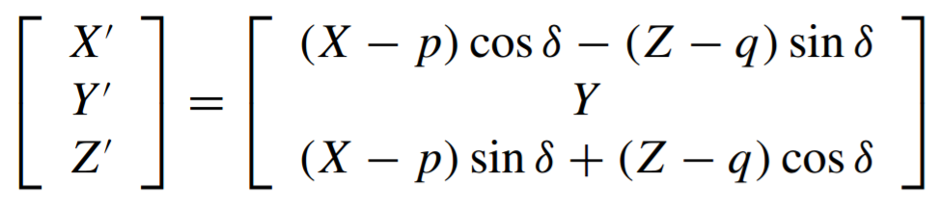
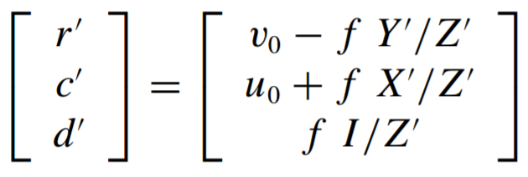
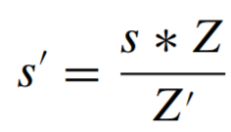
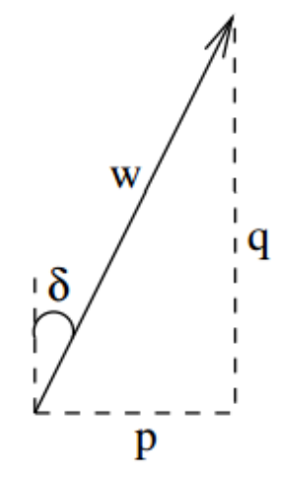
Matching SIFT Features
Predicting relative 3D position
  (u₀,v₀) image center coordinates
Predicting expected disparity
  I interocular distance
  f focal length
Predicting expected scale
Search for SIFT landmarks match based on criteria
  Within 10x10 pixel region
  Scale S and S’ must be within 20% of each other
  Orientation within 20 degrees
  Disparity d and d’ must be within 20%

Slide 17
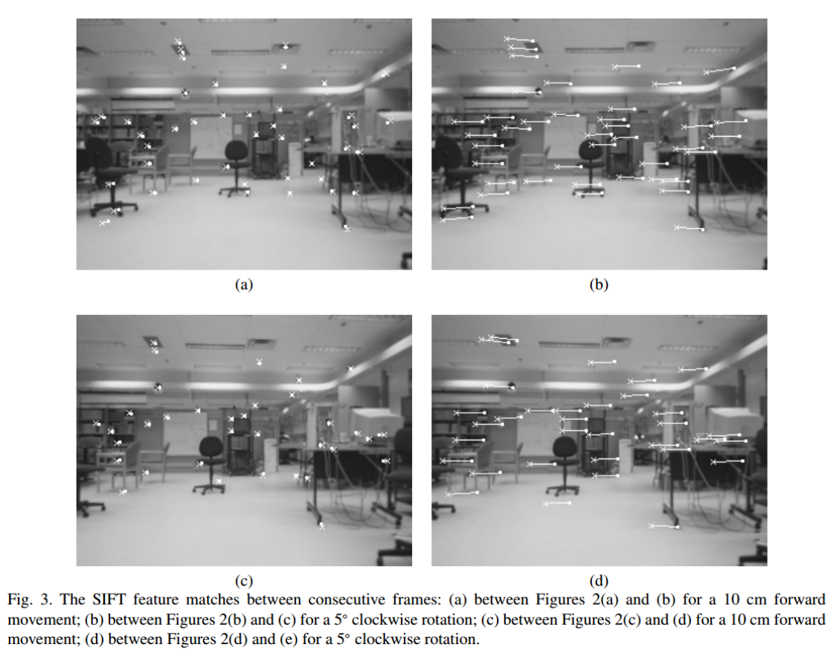

Slide 18
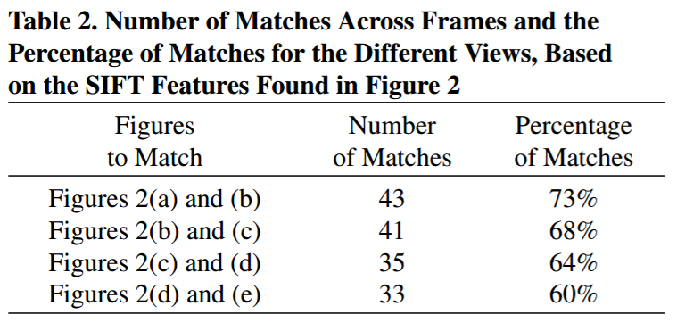
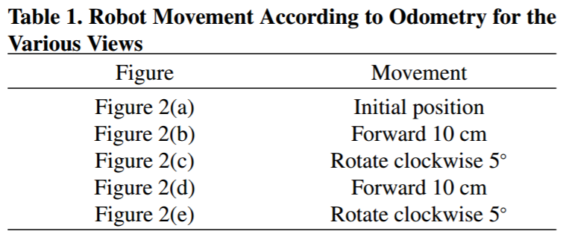

Slide 19




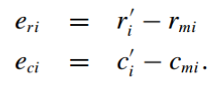

Least-Squares Minimization
Least Squares is used to determine camera movement
Tells us the x, y, z, yaw, pitch, roll that would bring the best alignment between the matched SIFT features.
P =
e_{ri} = row and column
errors of the
i^{th} match hat represents least
E_{i} = residual error. squares
Features with big
E_{i} are eliminated

Slide 20
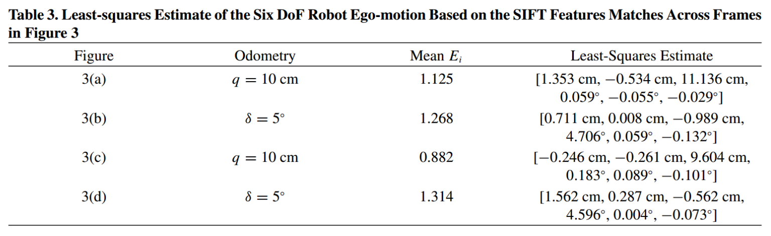

Slide 21
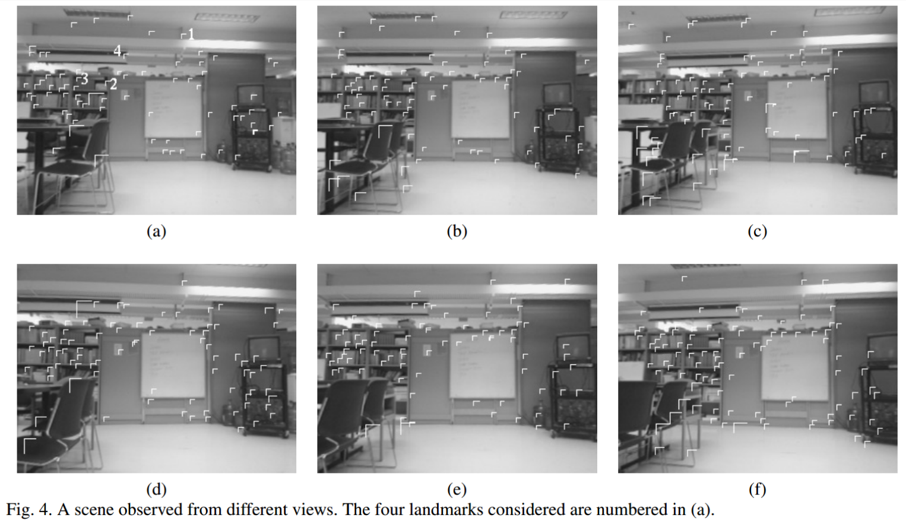
b – original position, a – 10º left, c - 10º right
e – 60 cm in front, d – 60 cm in front and 10º left, e – 60 cm in front and 10º right

Slide 22
Database
Each matched SIFT feature is logged in a database of landmarks to match features in future views.
Specifically, the [x,y,z,s,o,l] are logged for each landmark
Each landmark has a miss count – number of times they are expected to be matched but aren’t. If the miss count is reaches a threshold N, the landmark is pruned from the database.

Slide 23
Results

Slide 24
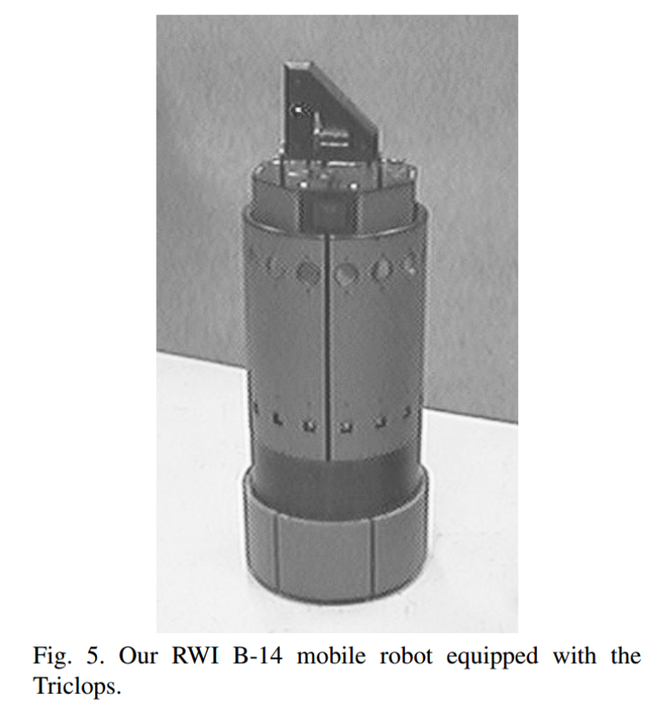

Slide 25
Experiment
Set height change parameter to 0 (not ascending or descending in elevation)
Manually drive robot one loop around a chair and back
  Just testing SIFT features and ego-motion, not navigation
At end, 249 320x240 frames were taken with 3590 SIFT landmarks logged.
Each iteration taking 0.5 seconds
40~60 matches each frame

Slide 26
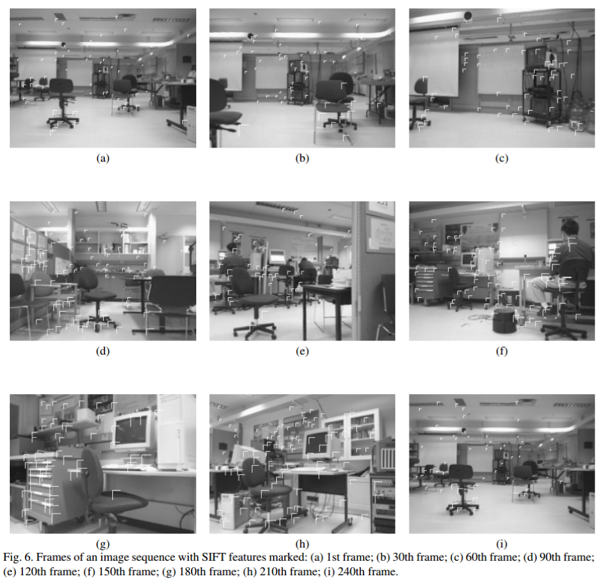

Slide 27
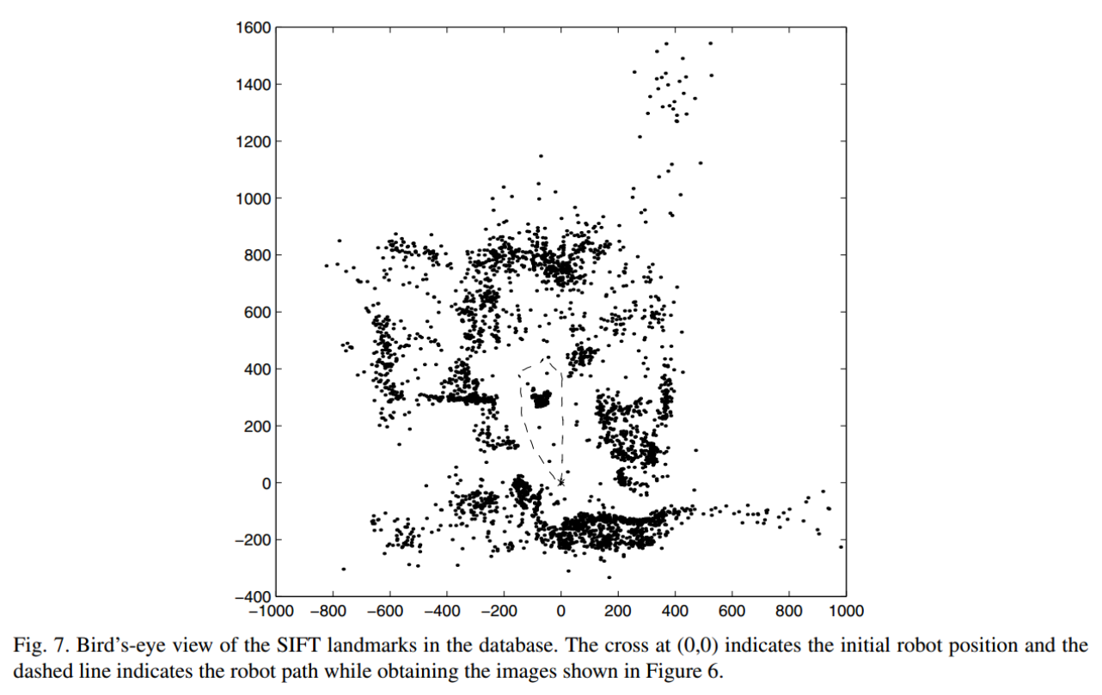

Slide 28
Improvements

Slide 29
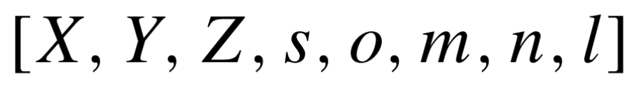
Improvements – SIFT Database
Include consecutive miss count, l, general miss count m in data for each SIFT landmark, and n the number of times it has been seen.
  Only include SIFT features which have n>=3 (must be seen 3 or more times to be logged)
    Used to discard false positives due to noise
SIFT features are not invariant to changes in PoV or multiple viewpoints (if orientation is for than 20 degrees for example)
  The same object could be not counted because it looks different from a different viewpoint
  Add a view vector, v, to hold the scale and orientation for a SIFT feature for each viewed direction with its each s and o.

Slide 30
Improvements – Error Modeling
Quantify the reliability of estimations
  Incorporating a covariance matrix into each SIFT landmark in the database
  Employ a Kalman Filter for each landmark to update state info
  Use a covariance matrix for the robot position
    Gathered from the odometry data of the robot
      Odometry: using data from motion sensors to estimate change in position over time
When a match is found between frames, the covariance matrix for the landmark will be augmented using the robot pose covariance matrix and then combined with the existing covariance matrix in the database.

Slide 31
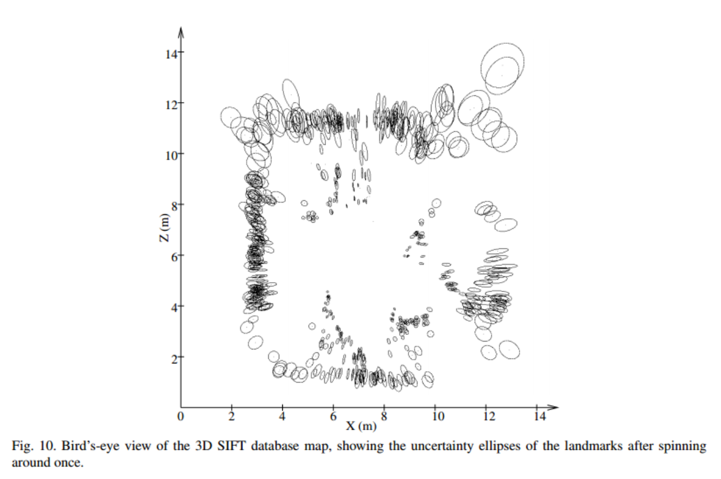

Slide 32
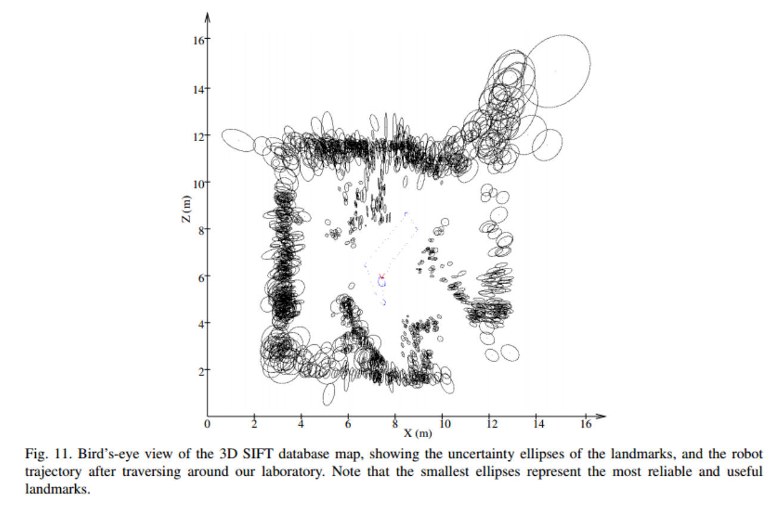

Slide 33
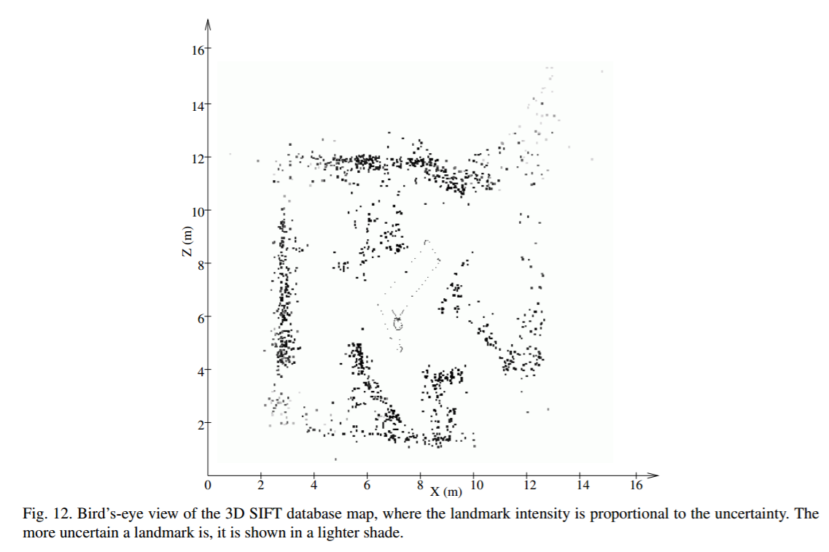

Slide 34
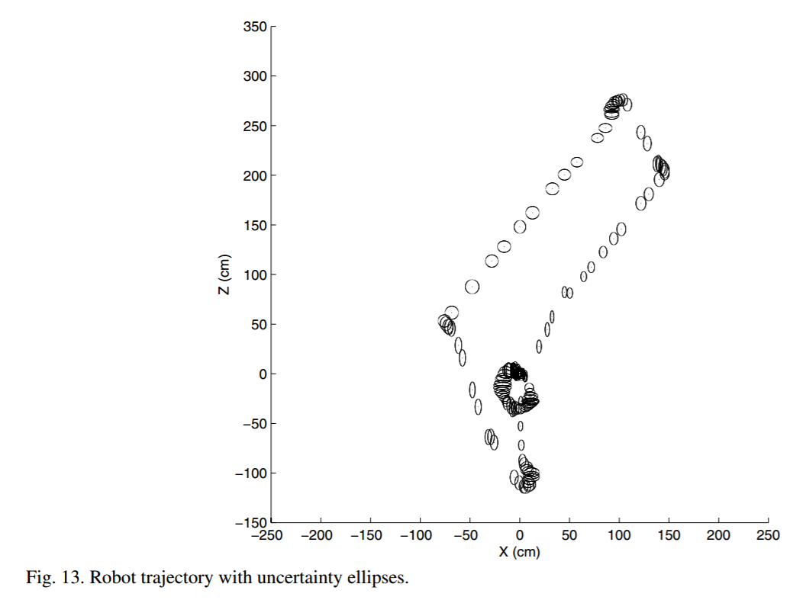

Slide 35
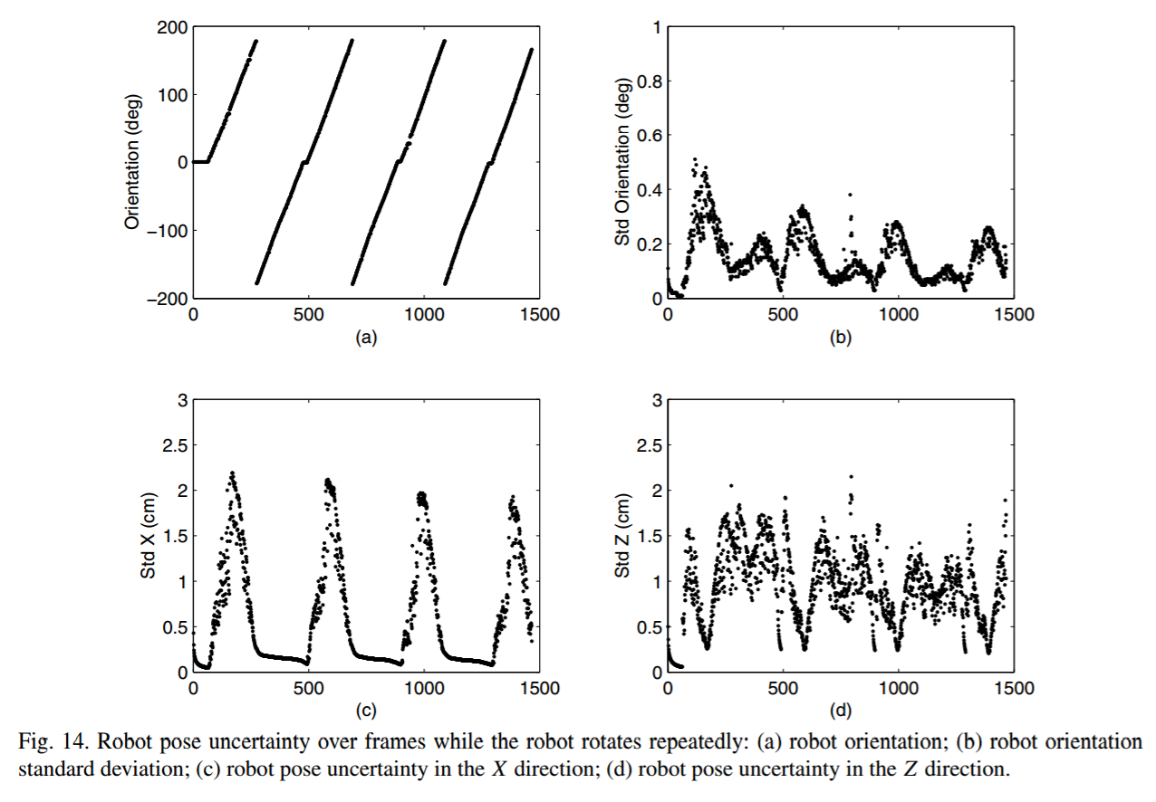

Slide 36
Conclusion

Slide 37
Conclusion
Vision based SLAM using SIFT
Time and Memory efficacy are very important
Algorithm runs at 2 Hz for 320x240 sized images
Tested using a 700 MHz processor

