Slide 1
Learning Semantic Scene Models From Observing Activity in Visual Surveillance
Dimitios Makris and Tim Ellis (2005)
Presented by Steven Wilson

Slide 2
Overview
Video surveillance
Motion Detection
Entry/exit zones using EM algorithm
Stop zones using ground plane coordinates
Route modeling and merging

Slide 3
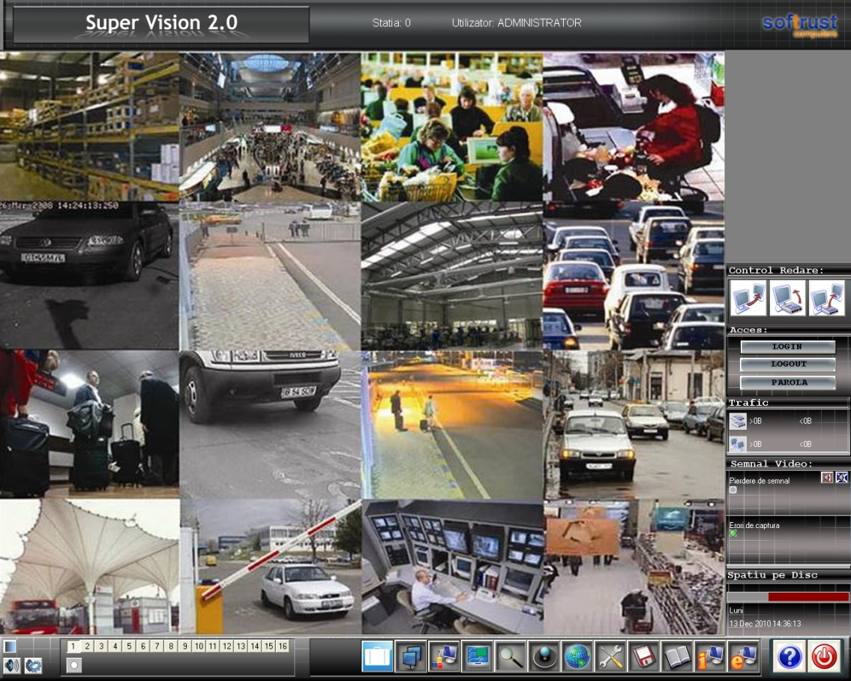
Motivation
Multiple video feeds multiplexed to monitor
Information overload leads to operator fatigue
Surveillance system fails due to inattention
{1} How long does it take to analyze 16 scenes?

Slide 4
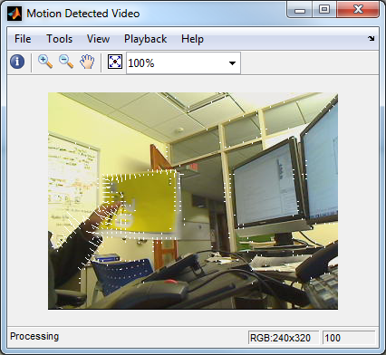
Previous Work
VMD’s – Video motion detectors
  Takes difference between pixels across frames
  Unable to determine context
  Any motion in the FOV causes an alarm
{2} Motion Detection in MATLAB

Slide 5
Previous Work
Automating the interpretation of a human is a complex task
Many factors such as context, time, and date can affect detection of a suspicious activity
  Stumbling into a cab at 2AM in front of a bar (OK)
  Stumbling into work at 8AM (Not OK)
More recent techniques use can track an object across several camera FOV’s using mosaicking
Howard and Buxton proposed a polygon based semantic model, and applied it manually

Slide 6
Goals
The system must have a low FAR
  High false alarm rates cause the operator to ignore the system
    Check engine light
    Windows security updates
System must be automated
  Video footage is suitable for automated training due to the large amount of data
  Algorithms requiring manual training must be reconfigured for changes in FOV
  Unsupervised training results in high level learning

Slide 7
Motion Tracking
Pixels classified as fore or background
  Most likely Gaussian model
  Blobs from the previous scene are linked to the current scene using a Kalman filter (LQE*)
    Uses a weighted average
    Higher weights given to estimates with greater certainty
  Blobs may be undetected for a few scenes due to illumination changes or noise
    *Linear Quadratic Estimation

Slide 8
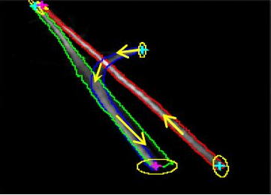
Semantic Scene Model
Zones in the scene are
  Labeled based on activity
  Identified entry/exit zones, paths, and stop zones
  Identified using an unsupervised method
Applications
  Vehicle path automation
  Pedestrian safety
{3} Entry zones and paths

Slide 9
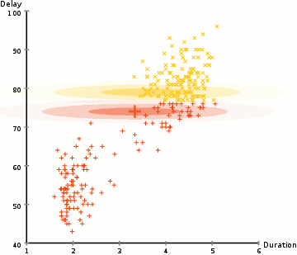
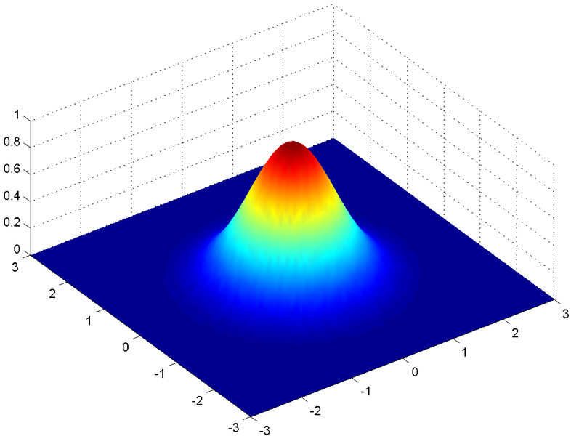
Expectation Maximization algorithm (E-M)
  Collects start/exit points for each trajectory
    Set number of “clusters” - N
    Overestimate the number of entry/exit zones
  Uses 2D GMM (Gaussian Mixture Models)
{4} Iterative EM algorithm
{5} 2D Gaussian Probability

Slide 10
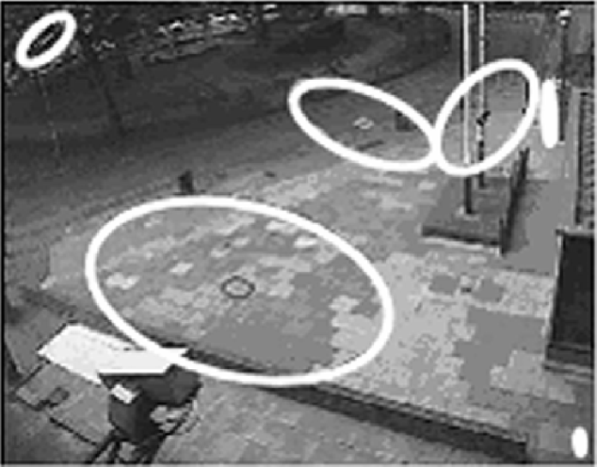
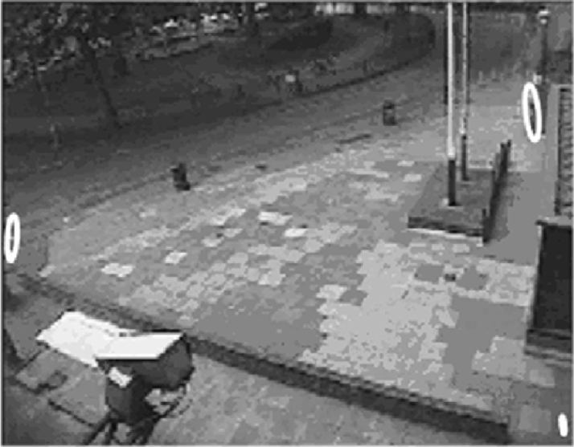
Discarding Noise
The scene on the right has 3 entry/exit zones – N_{e} = 3
  Not logical to have an entry in the middle of an unobstructed FOV
Tracking failure noise zones - N_{tf}
  Caused by partial object tracking, partial path tracking
  Wide gaussian distribution
Semi-stationary noise zones N_{sm}
  Camera vibration, window reflections
  Dense, narrow gaussian distribution
N = 6, Ne = 2, Ntf = 3, Nsm = 1
3 correct entry/exit zones Ne = 3

Slide 11
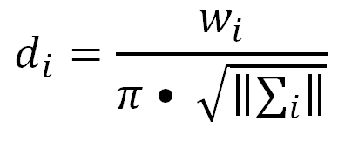
Discarding Noise
Density is proportional to the probability of a cluster divided by the covariance matrix norm
  Low density is caused by
    Low number of entry/exit points
    Low correlation between points

Slide 12
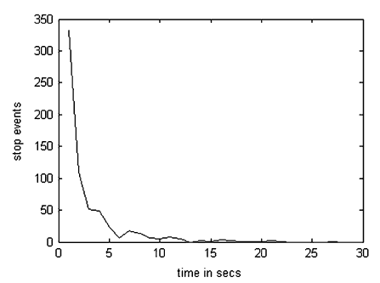
Stop Zones
Target speed is lower than some threshold
GMM applied to ground plane coordinates
  Normalize differences in perspective
Indicate queues, rest areas, traffic congestion
Stop event duration
is measured
  Can be modeled
  as an exponential

Slide 13
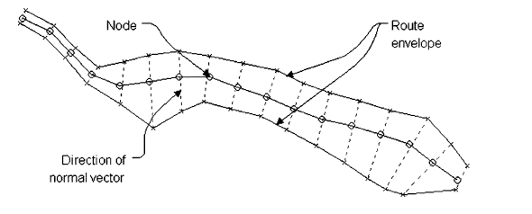
Route Modeling
Vehicles and pedestrians use predefined routes
Route estimated by main axis and borders
  Equidistant nodes on the main axis (spline)
  Nodes are characterized by
  2D position vector
  weight factor of usage, w_{i}
  Normal vector
  2 boundary points
  PDF of node usage across route

Slide 14
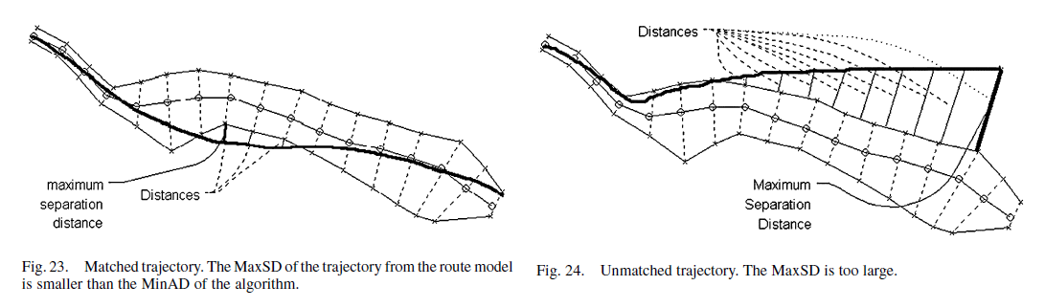
Route Model Learning Procedure
First trajectory initializes the route model
Second trajectory is compared to model
  MaxSD* < MinAD** → Route is updated
  Trajectory does not match model → New model
*seperation distance, **allowable distance

Slide 15
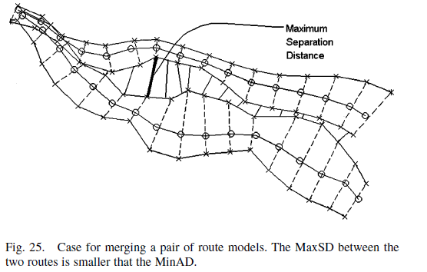
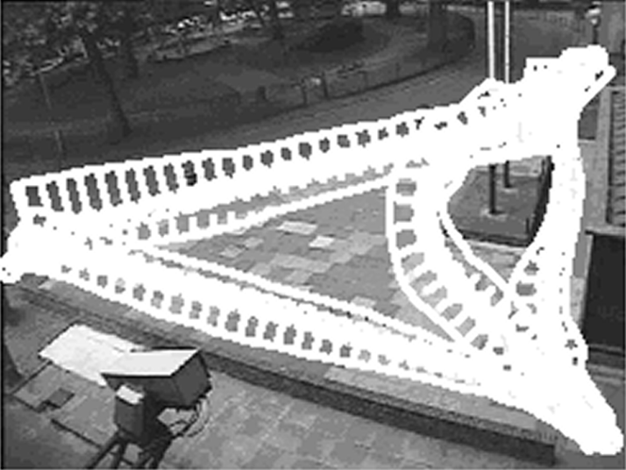
Route Model Learning Procedure
Each route is compared with new model
  If routes have sufficient overlap, then merge
New routes are learned within 8.46 seconds
  Depends on resample factor ‘r’
Route models learned over 24 hour run

Slide 16
Evaluation
3 entry/exit zones are classified
  100% success rate for 3 ≤ N’ ≤ 8 (5 trials)
  Overestimation of entry/exit zones decreases performance
  MinAD must be kept above 10 to avoid creating multiple narrow routes for the same path
    Moderate amount of tuning
  Validation dataset was evaluated
    97 of 100 trajectories were correctly classified

Slide 17
Applications
Annotate surveillance
  Pedestrian enters the scene at entry zone A
Accident/ traffic congestion detection
  Stop zone has average time of 300 seconds
Infrastructure optimization
  5,000 vehicles entered this single lane road in eight hours

Slide 18
Conclusion
Route classification within 8 seconds
  Using Pentium 3 processor
Very feasible for embedded systems
  Comparing distance between trajectories and routes requires minimal hardware
  Most hardware intensive feature is 2D GMM
Entirely automated learning model
  User inputs required for entry/exit zones
    Parameter α for noise threshold
    N’ for estimation of number of zones
  MinAD, ‘r’ kept constant for similar applications

Slide 19
References
{1} http://www.softrust.ro/Produse/Securitate/super-vision-DVR.php_files/dvr.jpg
{2} http://www.mathworks.com/help/imaq/examples/live-motion-detection-using-optical-flow.html
{3} http://www.ee.cuhk.edu.hk/~xgwang/trajectory.html
{4} http://upload.wikimedia.org/wikipedia/commons/6/69/EM_Clustering_of_Old_Faithful_data.gif
{5} http://en.wikipedia.org/wiki/File:Gaussian_2d.png

