Slide 1
Eigenfaces for Recognition
Student: Yikun Jiang
Professor: Brendan Morris

Slide 2
Outlines
Introduction of Face Recognition
The Eigenface Approach
Relationship to Biology and Neutral Networks
Conclusion

Slide 3
Introduction of Face Recognition
The human ability to recognize faces is remarkable
So, why do we need computational models of face recognition for Computers?
Could be applied to a wide variety of problems: Criminal Identification, Security systems, Image and Film Processing, Human-Computer Interaction

Slide 4
Introduction of Face Recognition
Developing a computational model is very difficulty
Because they a natural class of objects

Slide 5
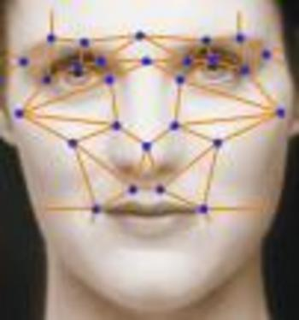
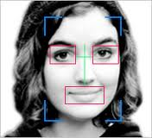
Introduction of Face Recognition
Background and Related Work
Much of the work in computer recognition of faces has focused on detecting individual features such as the eyes, nose, mouth and head outline.

Slide 6

Eigenvalue and Eigenvector
λ is Eigenvalue of square matrix A
x is Eigenvector of square matrix A corresponding to specific λ

Slide 7
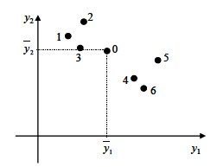
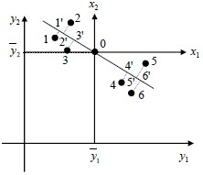

PCA: Principal Component Analysis
Dimension reduction to a few dimensions
Find low-dimensional projection with largest spread

Slide 8
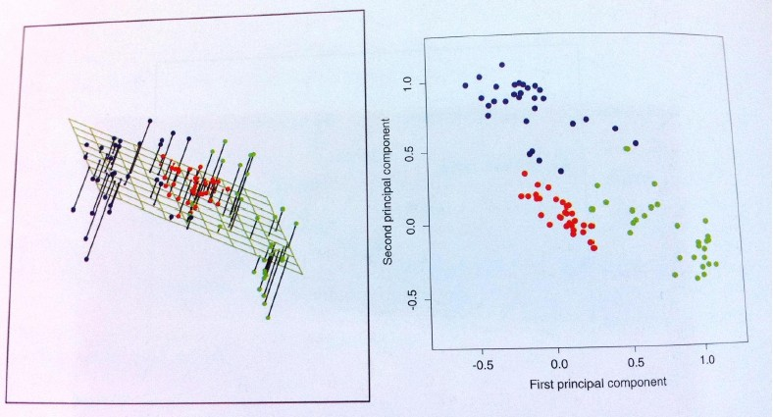
PCA: Projection in 2D

Slide 9
The Eigenface Approach
Introduction of Engenface
Calculating Eigenfaces
Using Eigenfaces to Classify a Face Image
Locating and Detecting Faces
Learning to Recognize New Faces

Slide 10
Introduction of Eigenface
Eigenvectors of covariance matrix of the set of face images, treating an image as a point in a very high dimensional space
Each image location contributes more or less to each eigenvector, so that we can display the eigenvector as a sort of ghostly face which we call an Eigenface.

Slide 11
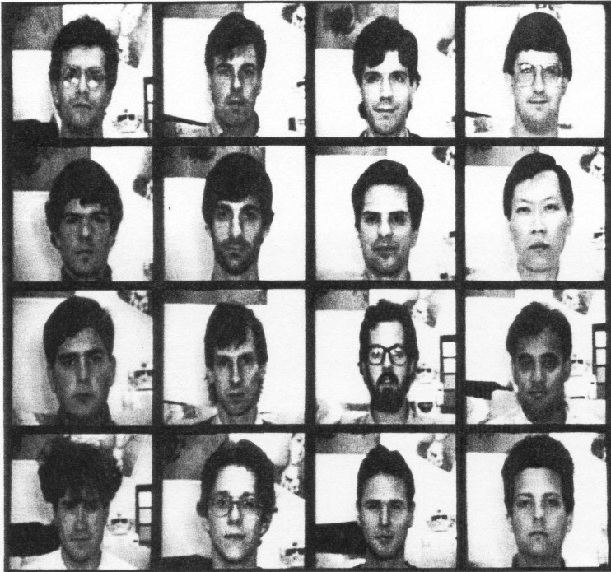
Operations for Eigenface
Acquire an initial set of face image (training set)

Slide 12
Operations for Eigenface
Calculate the eigenfaces from the training set, keeping only the M images that correspond to the highest eigenvalues. These M images define the face space.
Calculate the corresponding distribution in M-dimensional weight space for each known individual, by projecting their face image onto the ‘face space’

Slide 13
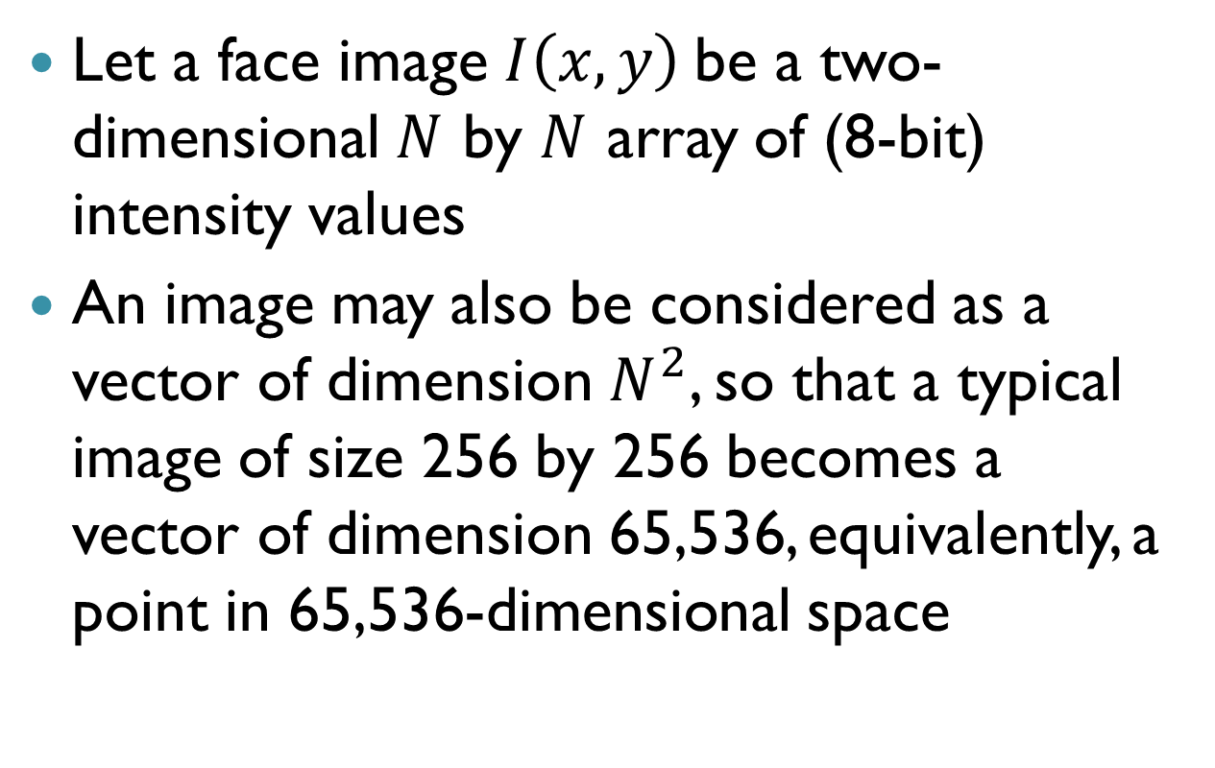
Calculating Eigenfaces
Let a face image $I\left(x,y\right)$be a two-dimensional $N$ by $N$ array of (8-bit) intensity values
An image may also be considered as a vector of dimension $N^{2}$, so that a typical image of size 256 by 256 becomes a vector of dimension 65,536, equivalently, a point in 65,536-dimensional space

Slide 14
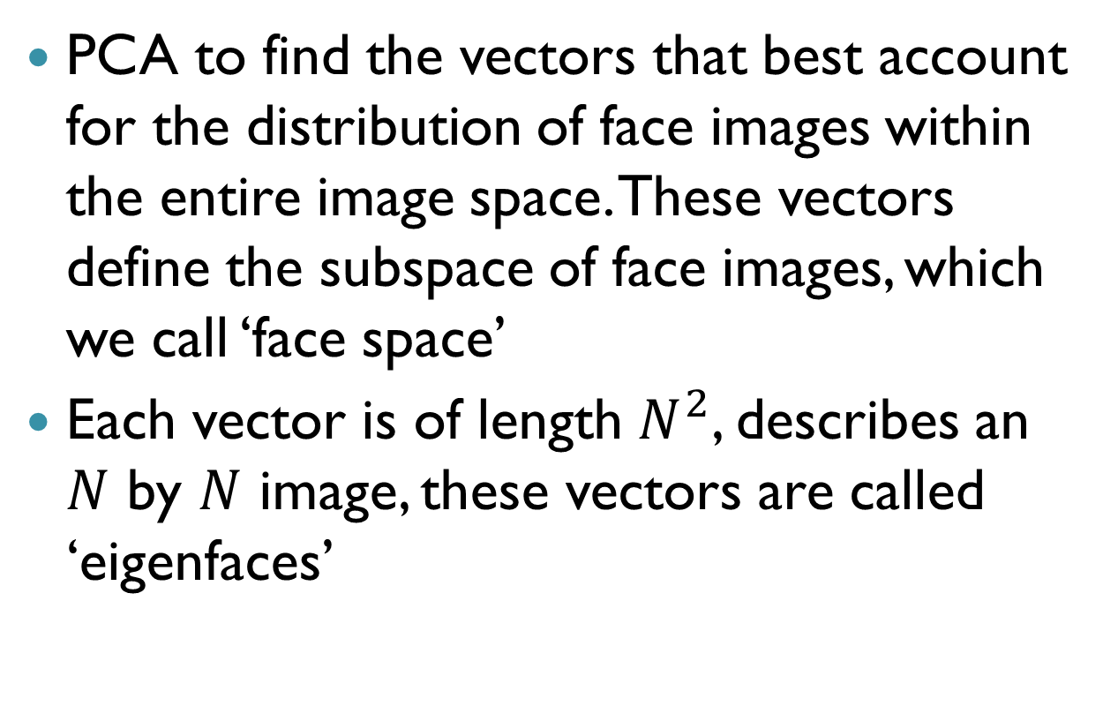
Calculating Eigenfaces
PCA to find the vectors that best account for the distribution of face images within the entire image space. These vectors define the subspace of face images, which we call ‘face space’
Each vector is of length $N^{2}$, describes an $N$ by $N$ image, these vectors are called ‘eigenfaces’

Slide 15
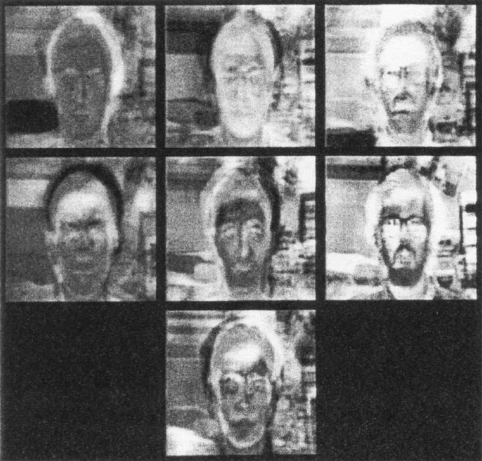

Slide 16
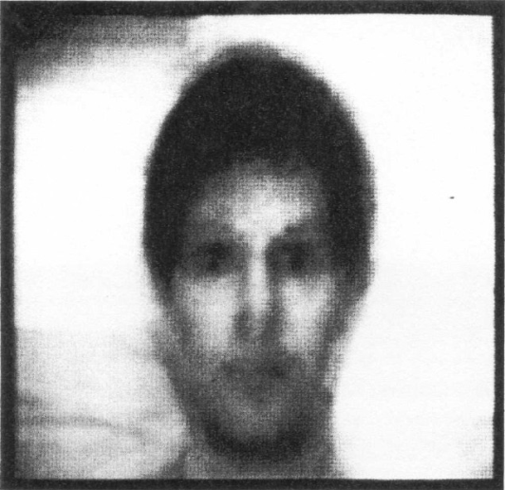
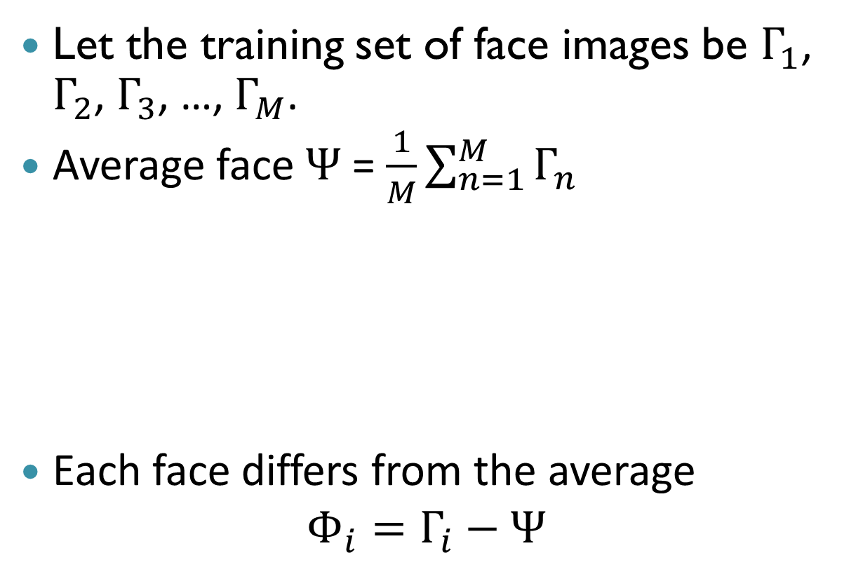
Calculating Eigenfaces
Let the training set of face images be $Γ_{1}$, $Γ_{2}$, $Γ_{3}$, …, $Γ_{M}$.
Average face $Ψ$ = $\frac{1}{M}\sum_{n=1}^{M}{Γ_{n}}$
Each face differs from the average
$$Φ_{i}=Γ_{i}−Ψ$$

Slide 17
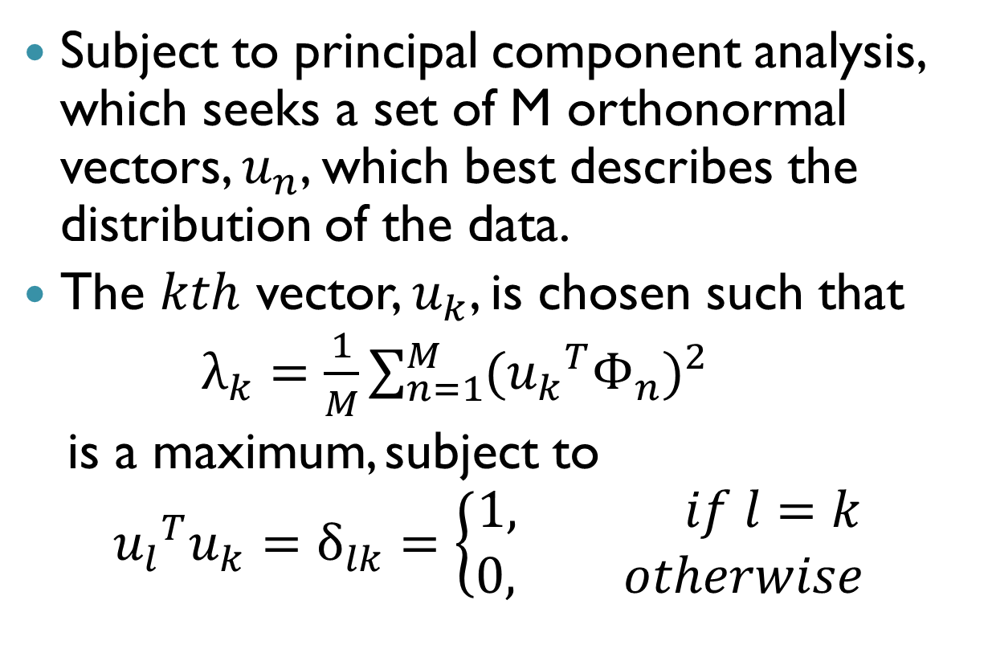
Calculating Eigenfaces
Subject to principal component analysis, which seeks a set of M orthonormal vectors, $u_{n}$, which best describes the distribution of the data.
The $kth$ vector, $u_{k}$, is chosen such that
$λ_{k}=\frac{1}{M}\sum_{n=1}^{M}{{({u_{k}}^{T}Φ_{n})}^{2}}$
is a maximum, subject to
$${u_{l}}^{T}u_{k}=δ_{lk}=\left\{\begin{aligned}1, if l=k \\ 0, otherwise\end{aligned}\right.$$

Slide 18
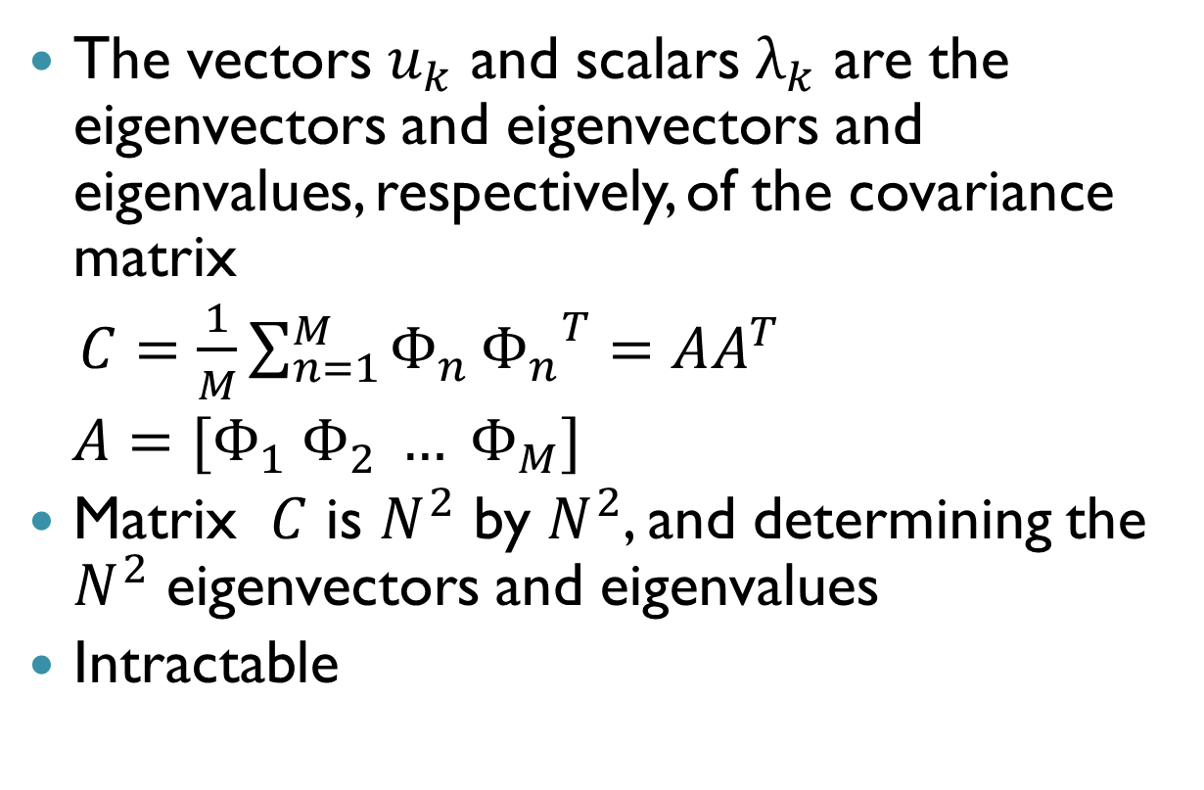
Calculating Eigenfaces
The vectors $u_{k}$ and scalars $λ_{k}$ are the eigenvectors and eigenvectors and eigenvalues, respectively, of the covariance matrix
$C=\frac{1}{M}\sum_{n=1}^{M}{Φ_{n}}{Φ_{n}}^{T}=AA^{T}$
$A=[Φ_{1} Φ_{2} … Φ_{M}]$
Matrix $C$ is $N^{2}$ by $N^{2}$, and determining the $N^{2}$ eigenvectors and eigenvalues
Intractable

Slide 19
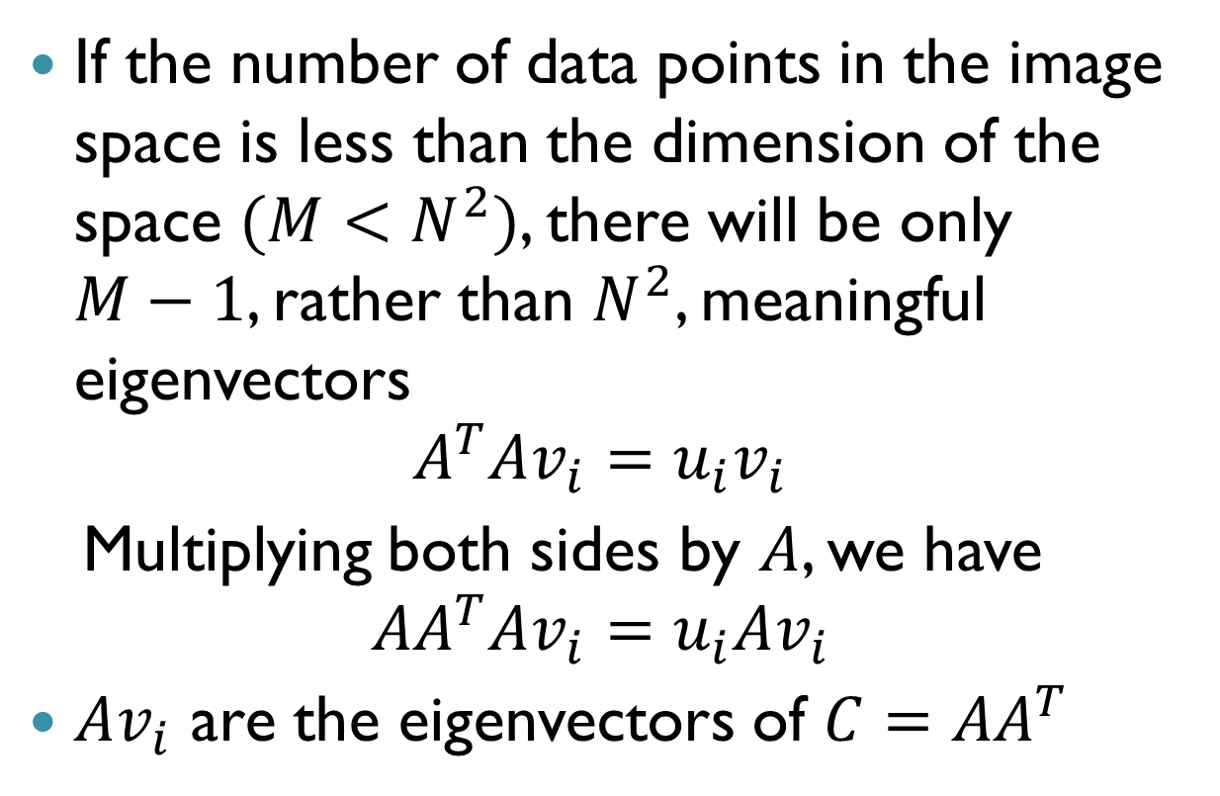
Calculating Eigenfaces
If the number of data points in the image space is less than the dimension of the space $(M<N^{2})$, there will be only $M−1$, rather than $N^{2}$, meaningful eigenvectors
$$A^{T}Av_{i}=u_{i}v_{i}$$
Multiplying both sides by $A$, we have
$$AA^{T}Av_{i}=u_{i}Av_{i}$$
$Av_{i}$ are the eigenvectors of $C=$ $AA^{T}$

Slide 20
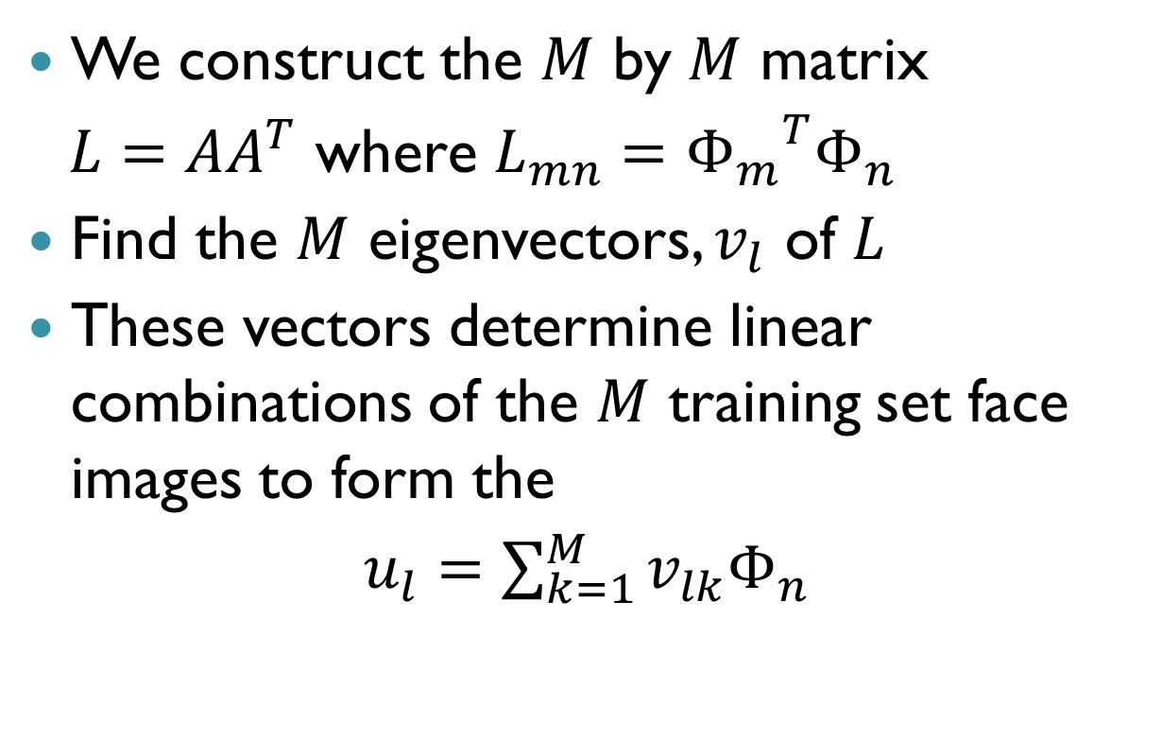
Calculating Eigenfaces
We construct the $M$ by $M$ matrix
$L=$ $AA^{T}$ where $L_{mn}={Φ_{m}}^{T}Φ_{n}$
Find the $M$ eigenvectors, $v_{l}$ of $L$
These vectors determine linear combinations of the $M$ training set face images to form the
$u_{l}=\sum_{k=1}^{M}{{v_{lk}Φ}_{n}}$

Slide 22


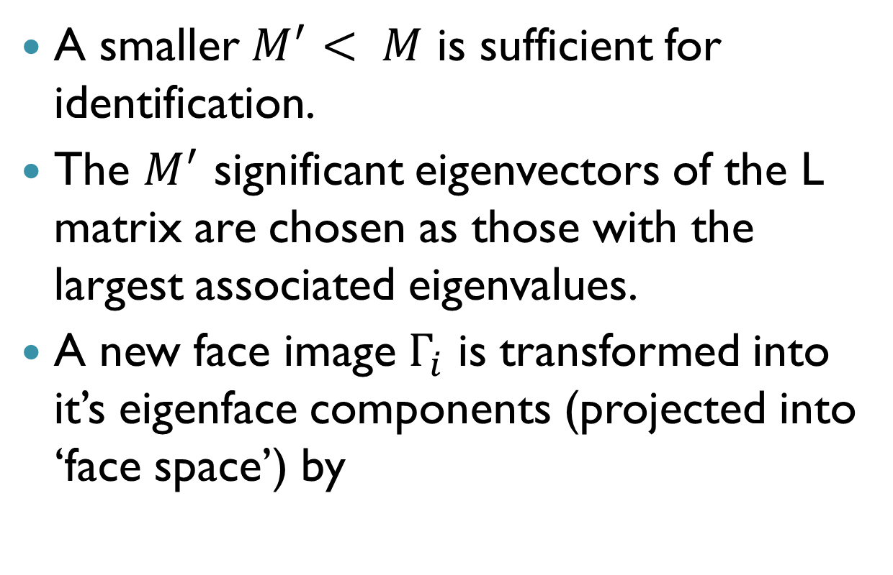
Eigenfaces to Classsify a Face Image
A smaller $M^{′}< M$ is sufficient for identification.
The $M^{′}$ significant eigenvectors of the L matrix are chosen as those with the largest associated eigenvalues.
A new face image $Γ_{i}$ is transformed into it’s eigenface components (projected into ‘face space’) by

Slide 23





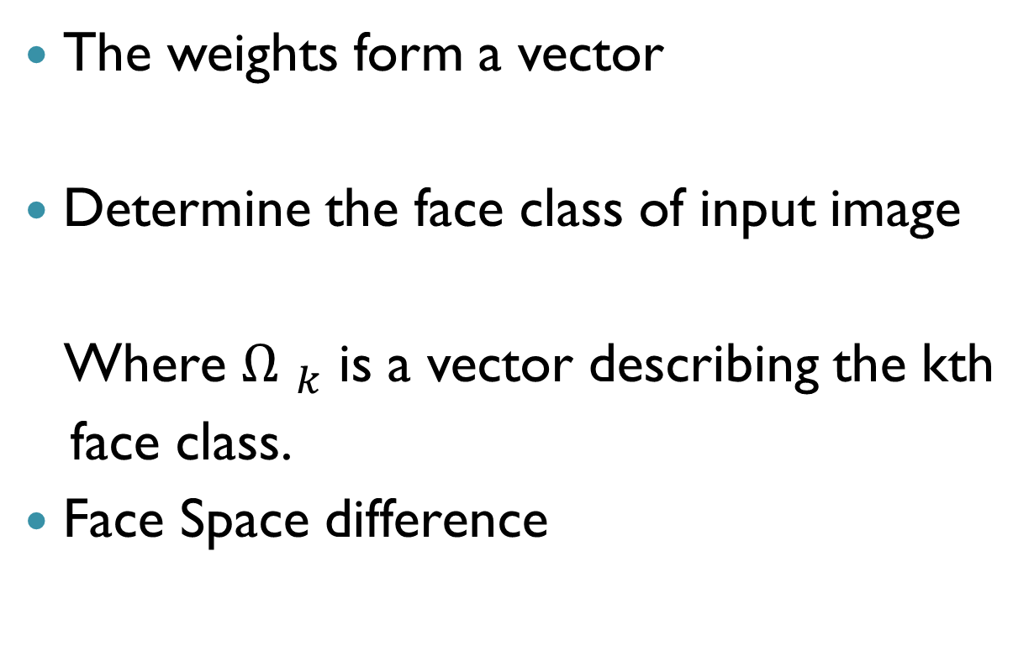
Eigenfaces to Classsify a Face Image
The weights form a vector
Determine the face class of input image
Where ${Ω }_{k}$ is a vector describing the kth
face class.
Face Space difference

Slide 24
Eigenfaces to Classsify a Face Image
Near face space and near a face class
Near face space but not near a known face class
Distant from face space and near a face class
Distant from face space and not near a known face class

Slide 25

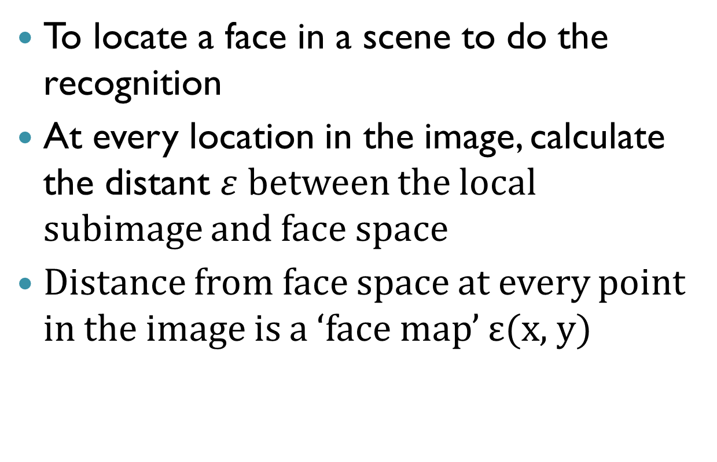
Locating and Detecting Faces
To locate a face in a scene to do the recognition
At every location in the image, calculate the distant $ε$ between the local subimage and face space
Distance from face space at every point in the image is a ‘face map’ $\text{ε}\text{(}\text{x}\text{, }\text{y}\text{)}$

Slide 26

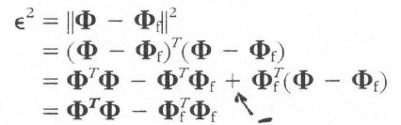


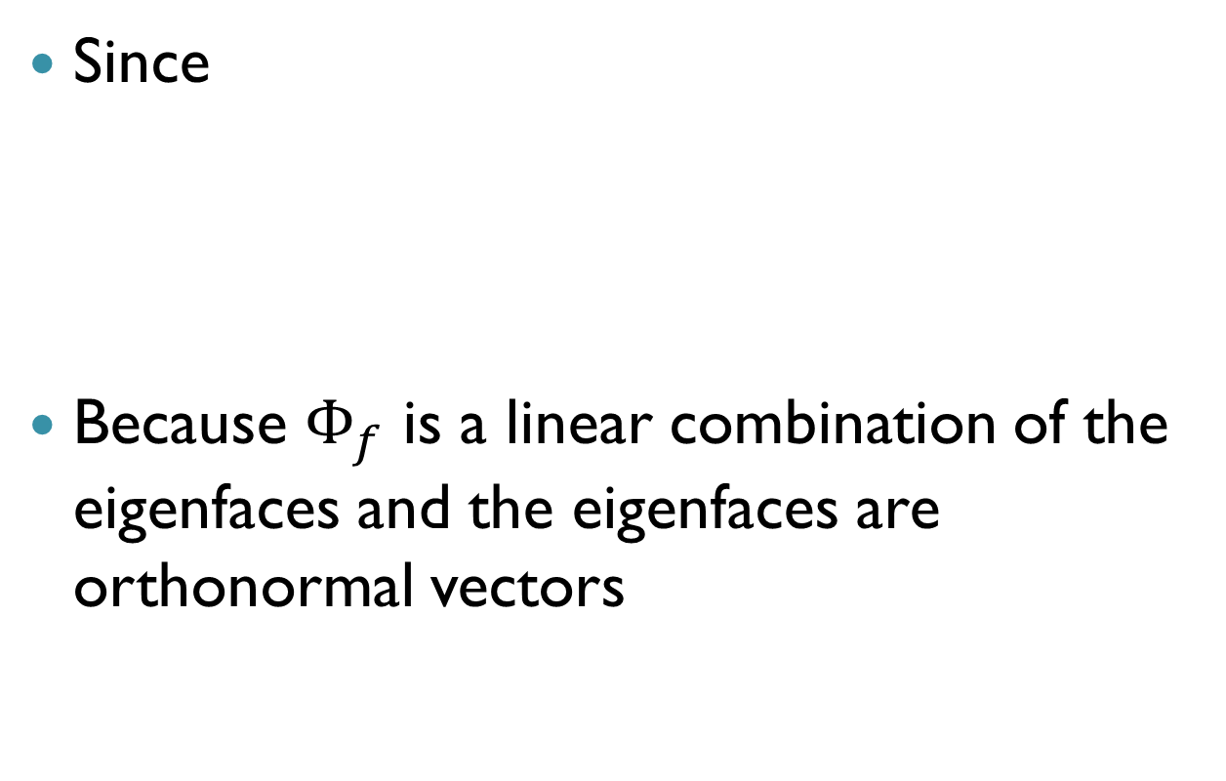
Locating and Detecting Faces
Since
Because $Φ_{f}$ is a linear combination of the eigenfaces and the eigenfaces are orthonormal vectors

Slide 27
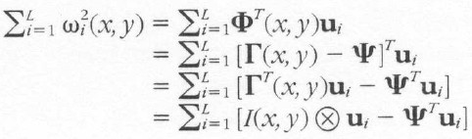
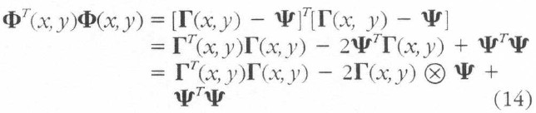
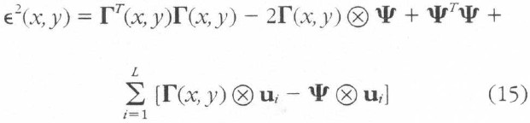
Locating and Detecting Faces
The second term is calculated in practice by a correlation with the L eigenfaces

Slide 28

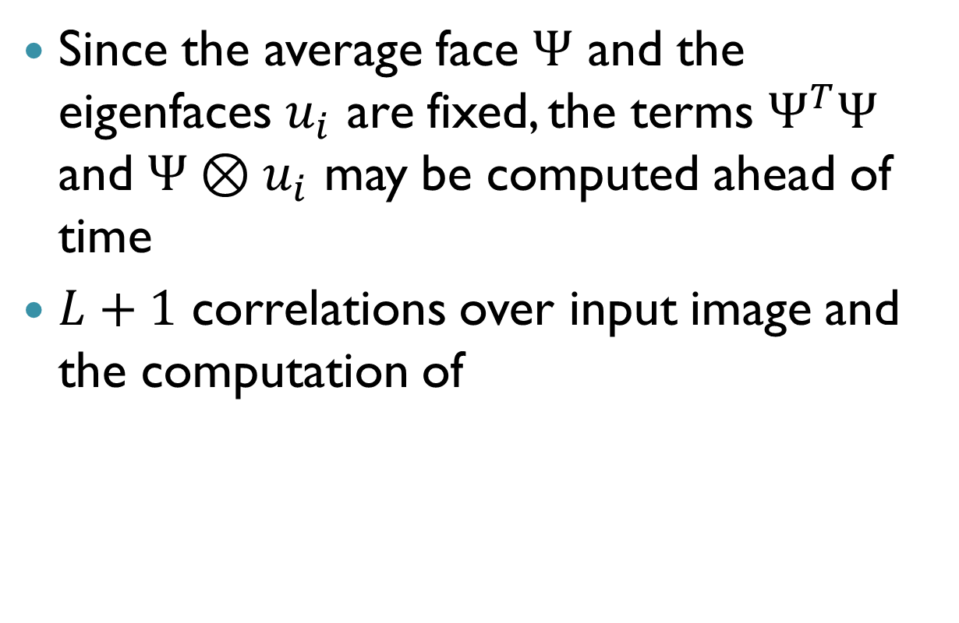
Locating and Detecting Faces
Since the average face $Ψ$ and the eigenfaces $u_{i}$ are fixed, the terms $Ψ^{T}Ψ$ and $Ψ⊗u_{i}$ may be computed ahead of time
$L+1$ correlations over input image and the computation of

Slide 29
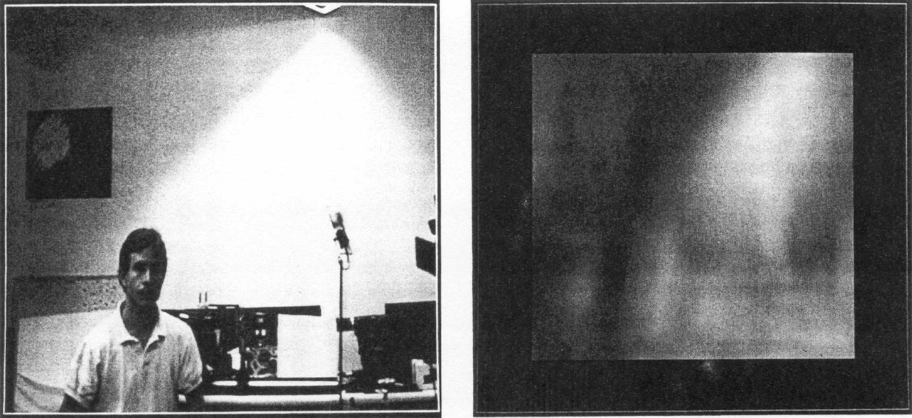
Locating and Detecting Faces

Slide 30
Relationship to Biology and Neutral Networks
There are a number of qualitative similarities between our approach and current understanding of human face recognition
Relatively small changes cause the recognition to degrade gracefully
Gradual changes due to aging are easily handled by the occasional recalculation of the eigenfaces.

Slide 31
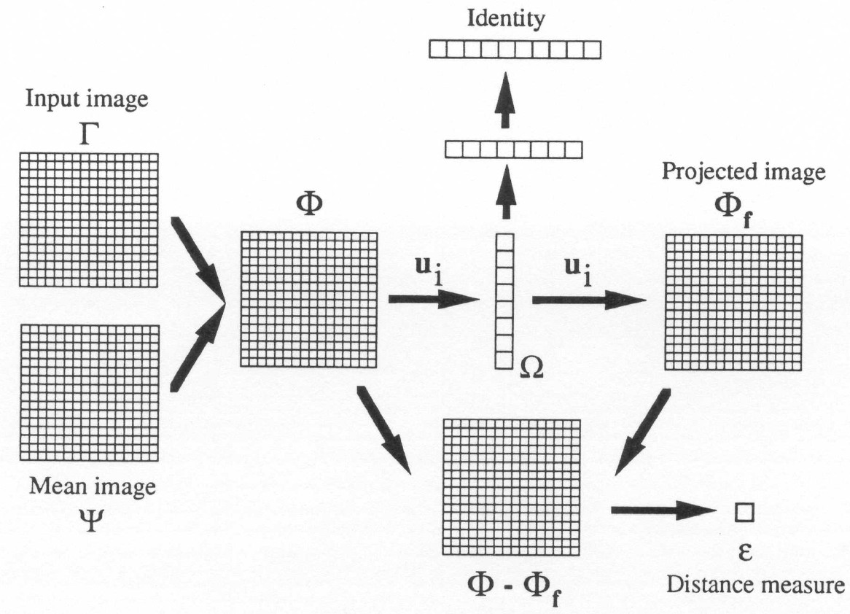

Slide 32
Conclusion
Eigenface approach does provide a practical solution that is well fitted to the problem of face recognition.
It is fast, relatively simple, and has been shown to work well in a constrained environment.
It can also be implemented using modules of connectionist or neural networks

