Slide 1
Lane and Vehicle Detection
A Synergistic Approach
Wenxin Peng

Slide 2
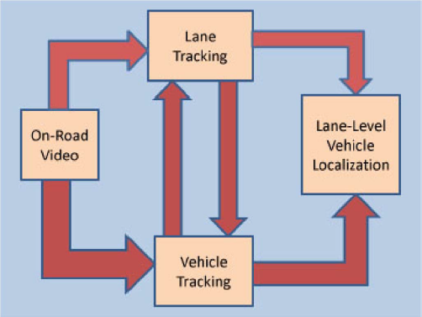
Structure
Lane and vehicle detection, localization and tracking

Slide 3
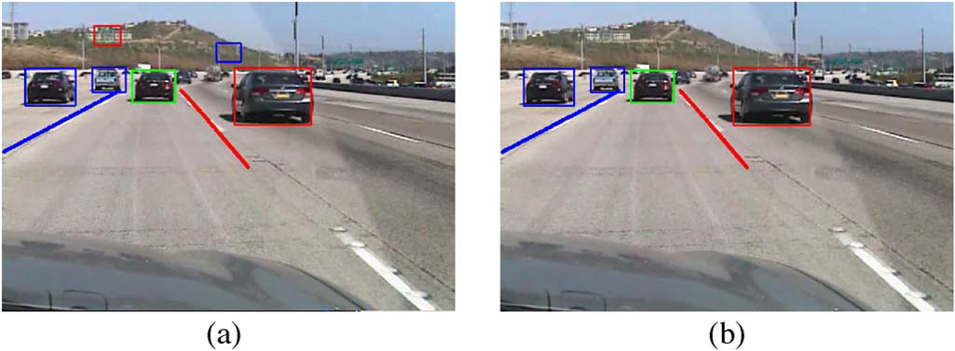
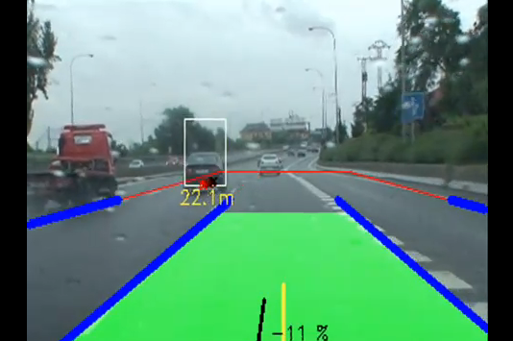
Structure
Reduce false positive results
Provide more information

Slide 4

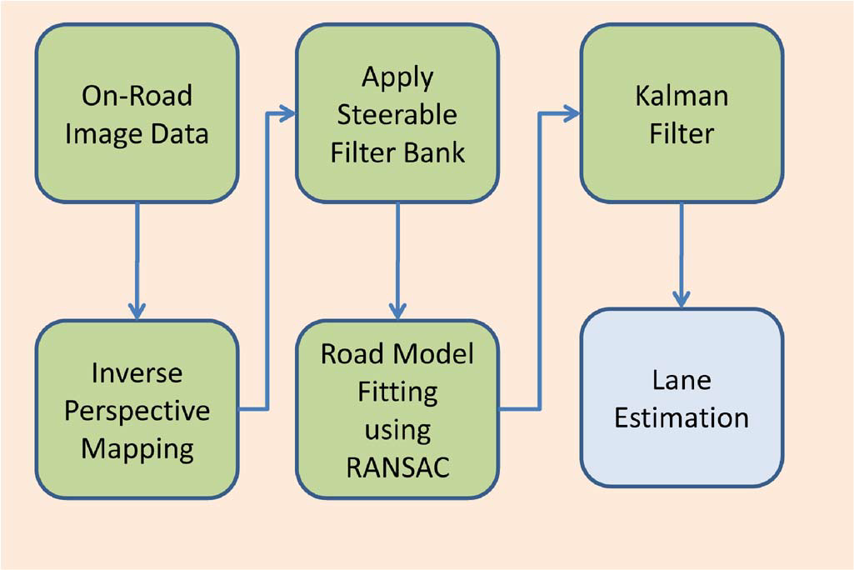
Lane Detection

Slide 5



IPM – Inverse Perspective Mapping
World to camera transformation
Z-direction Normalization
Parallel projection
$$x_{ground}=Hx_{image}$$

Slide 6
IPM – Inverse Perspective Mapping
Y’
Z
Y
eye
PN
Z’
X
X’
P
P

Slide 7
IPM – Inverse Perspective Mapping
Y’
Z
Y
ptEye
Camera space
Z’
ptAt
X’
X
World space

Slide 8

IPM – Inverse Perspective Mapping
$$x_{ground}=Hx_{image}$$
Lane：http://www.youtube.com/watch?v=v3mbr-qHBKI&NR=1&feature=endscreen

Slide 9

Steerable Filter

Slide 10
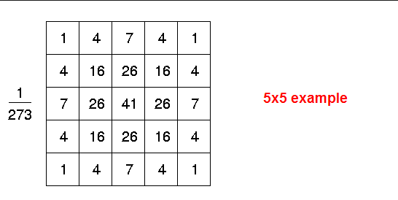
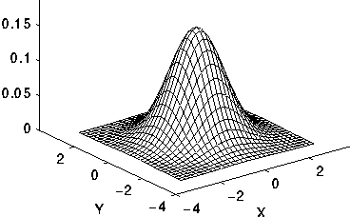


Steerable Filter
Gaussian:

Slide 11
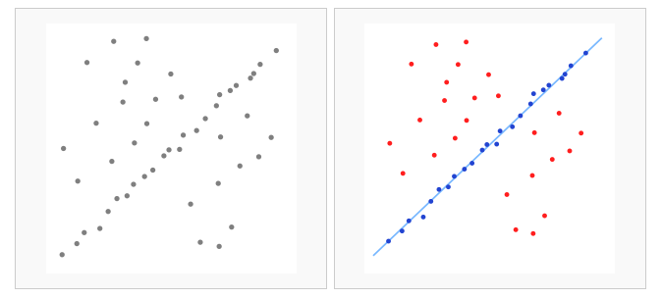
RANSAC-Random sample consensus

Slide 12
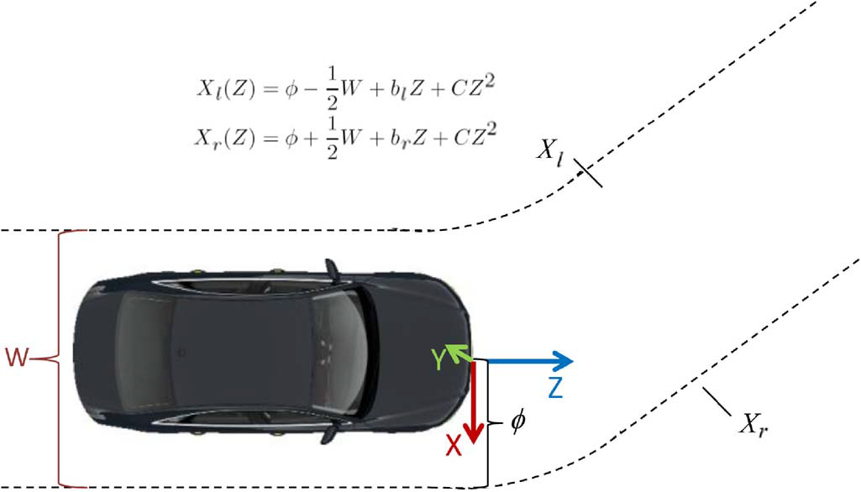

RANSAC-Random sample consensus

Slide 13
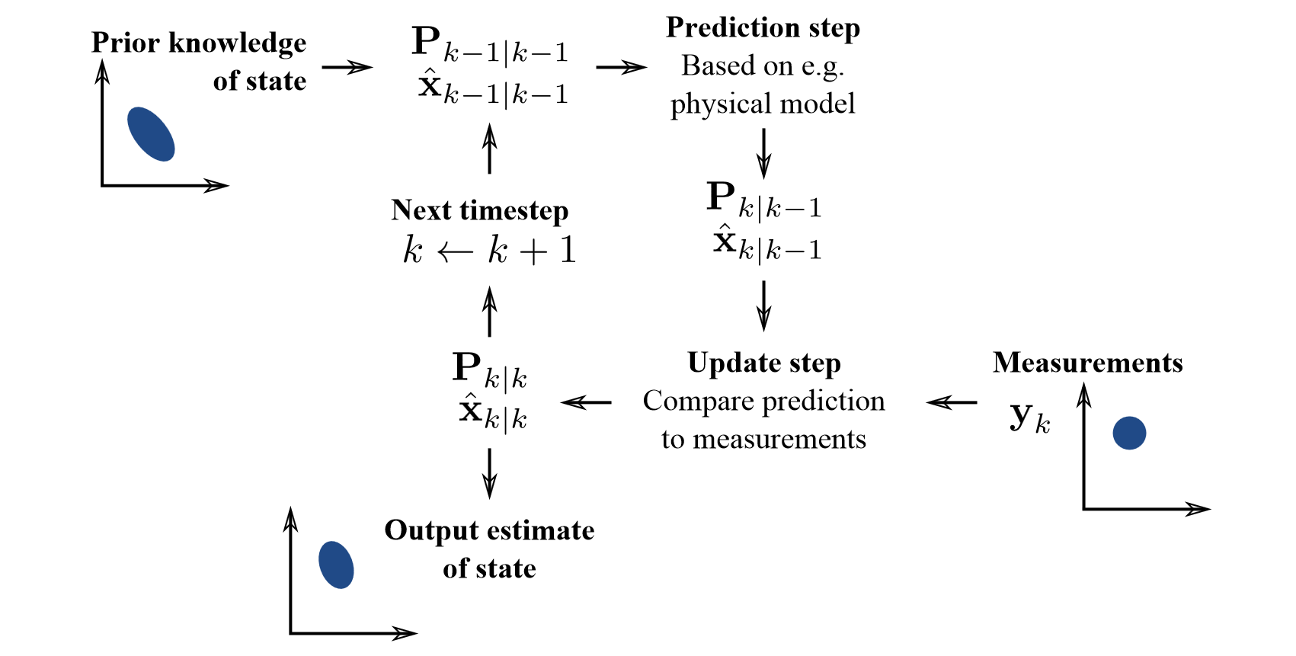
Kalman Filter

Slide 14
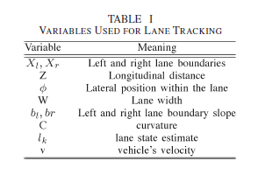
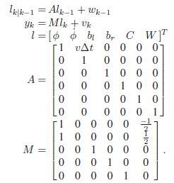
Kalman Filter

Slide 15

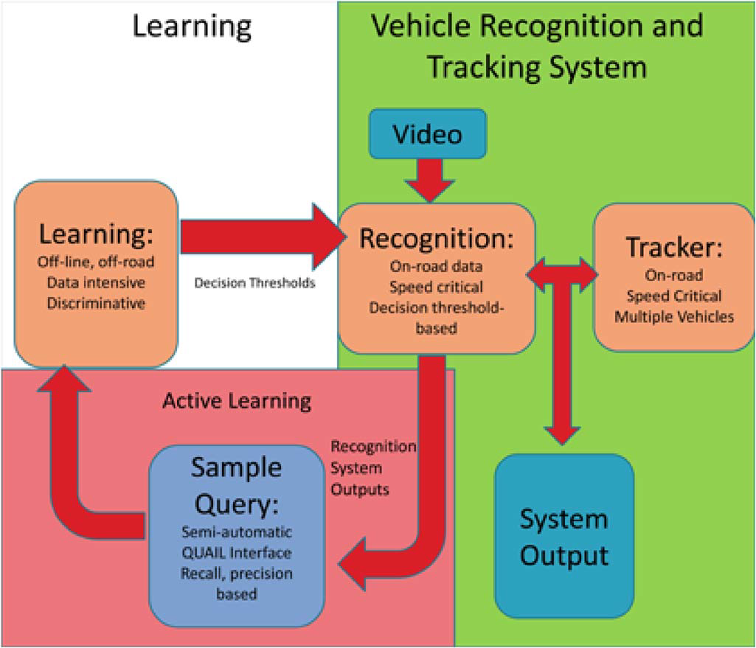
Car Detection

Slide 16
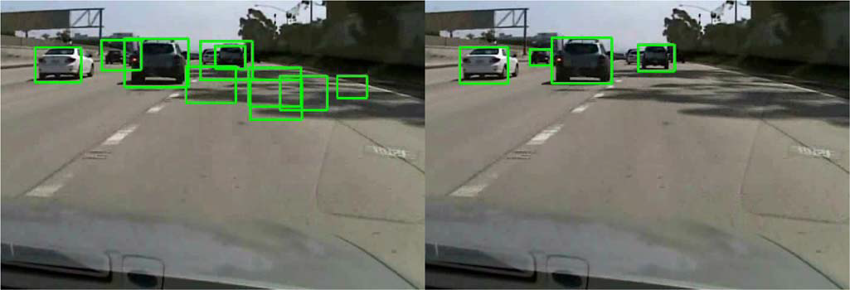
Car Detection
Active learning
Particle Filter
Sequencial Monte Carlo

Slide 17

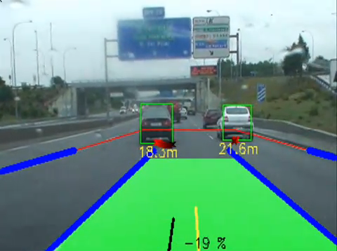
Tracking

Slide 18
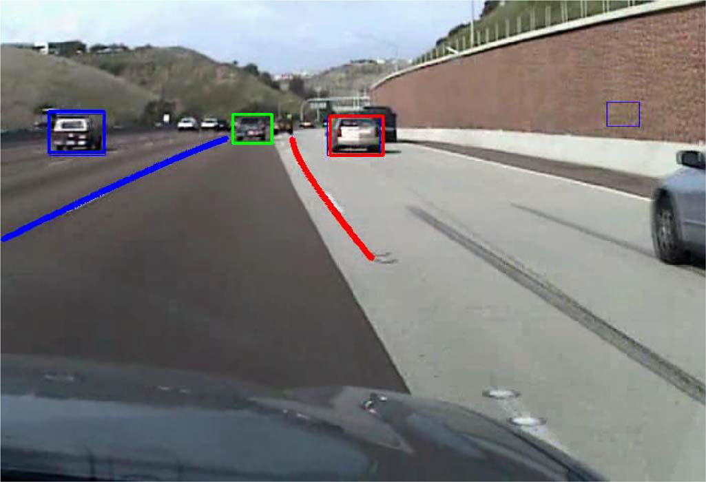
Results
Typical performance of integrated lane and vehicle tracking on highway
with dense traffic. Tracked vehicles in the ego-lane are marked green. To
the left of the ego-lane, tracked vehicles are marked blue. To the right of the
ego-lane, tracked vehicles are marked red. Note the curvature estimation.

Slide 19
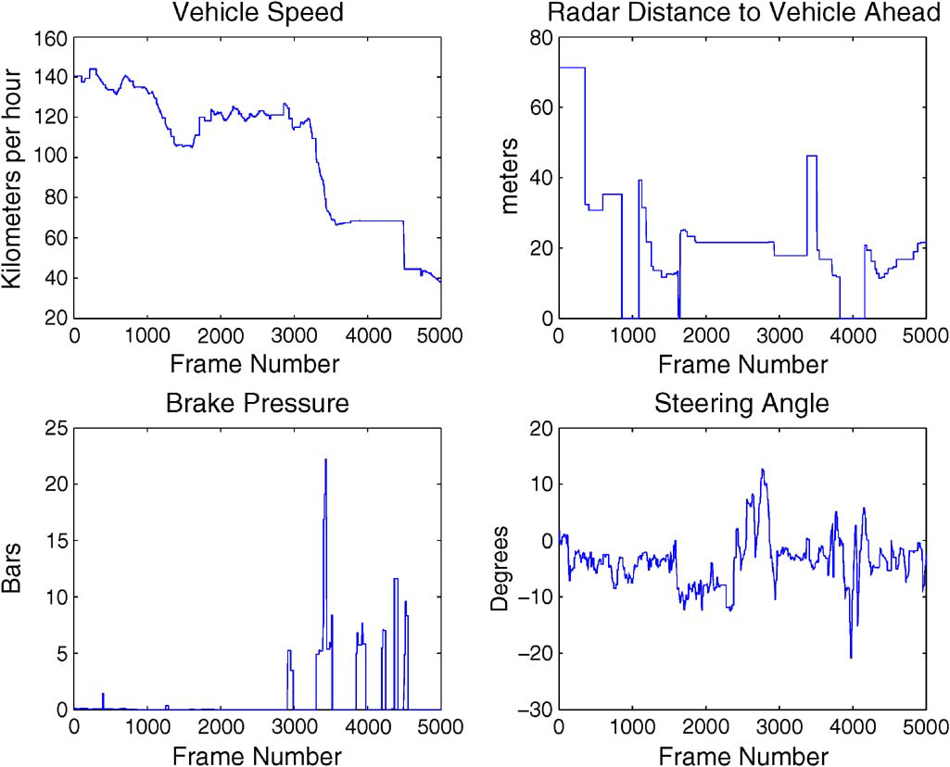
Results

Slide 20
Results
http://www.youtube.com/watch?v=ipXQFcAeovk&feature=endscreen&NR=1
http://www.youtube.com/watch?v=JmxDIuCIIcg&feature=endscreen&NR=1
http://www.youtube.com/watch?v=i6roGUznJ4A

Slide 21
Reference
‘Integrated Lane and Vehicle Detection, Localization, and Tracking: A Synergistic Approach’ Sayanan Sivaraman, Student Member, IEEE, and Mohan Manubhai Trivedi, Fellow, IEEE
‘Perspective and its Projection Transformation’, He Yuanjun (Department of Computer Science and Engineering, Shanghai Jiaotong University, Shanghai 200030,China)
3-D Study Notes, Guohua Lin, 2012/7/11
Wikipedia.com

Slide 22
Thank You!

