Slide 1
Kinect-based Image Segmentation
Presenter: Ali Pouryazdanpanah
Professor: Dr. Brendan Morris
University of Nevada, las vegas

Slide 2
Overview
Intuition and basic algorithms (k-means)
Advanced algorithms (spectral clustering)
Extend the methods for Kinect device

Slide 3
Clustering: intuition

Slide 4
What is clustering, intuitively?
Data set of “objects”
Some relations between those objects (similarities, distances, neighborhoods, connections, ... )
Intuitive goal: Find meaningful groups of objects such that
objects in the same group are “similar”
objects in different groups are “dissimilar”
Reason to do this:
exploratory data analysis
reducing the complexity of the data
many more

Slide 5
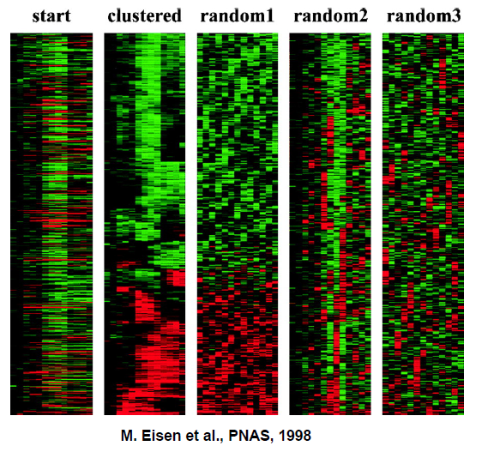
Example: Clustering gene expression data

Slide 6
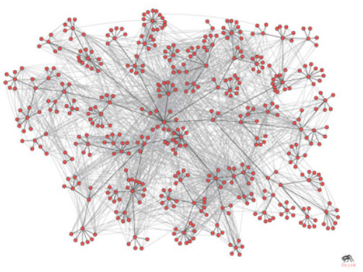
Example: Social networks
Corporate email communication (Adamic and Adar, 2005)

Slide 7
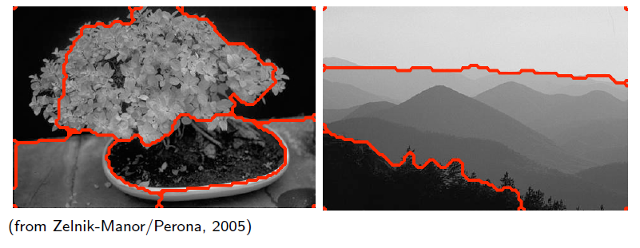
Example: Image segmentation

Slide 8
The standard algorithm for clustering: K-means

Slide 9
K-means – the algorithm
Given data points X1, ..., Xn $εR^{n}$.
Want to cluster them based on Euclidean distances.
Main idea of the K-means algorithm:
Start with randomly chosen centers.
Assign all points to their closest center.
This leads to preliminary clusters.
Now move the starting centers to the true centers of the current clusters.
Repeat this until convergence.

Slide 10
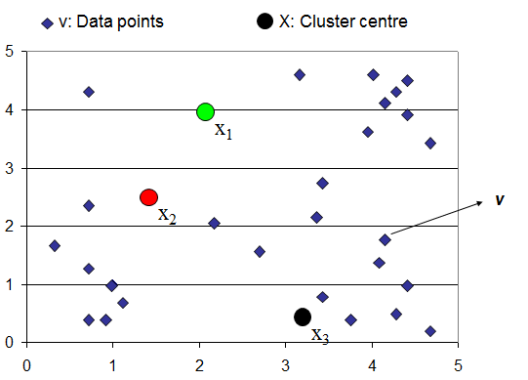

Slide 11
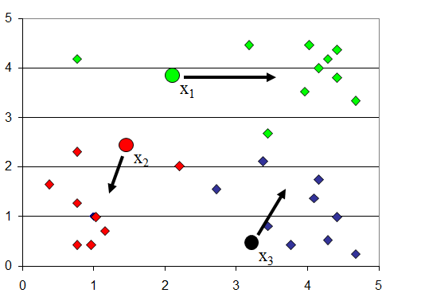

Slide 12
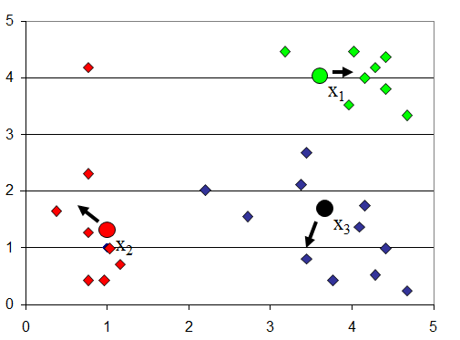

Slide 13
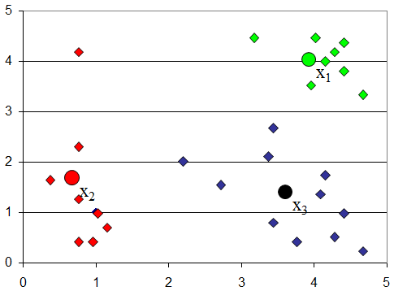

Slide 14
Input: Data points X1, ..., Xn $εR^{n}$, number K of clusters to
construct.
1- Randomly initialize the centers
2- Iterate until convergence:
2-1-Assign each data point to the closest cluster center,
that is define the clusters
2.2 Compute the new cluster centers by
Output: Clusters C1, ..., CK

Slide 15
K-means – summary
Advantages:
data automatically assigned to clusters
The ideal algorithm for standard clustering
Disadvantages:
All data forced into a cluster (solution: fuzzy c-means clustering and its versions)
Clustering models can depend on starting locations of cluster centers (solution: multiple clusterings)
Unsatisfctory clustering result to convex regions

Slide 16
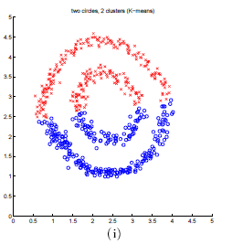

Slide 17
Spectral Clustering

Slide 18
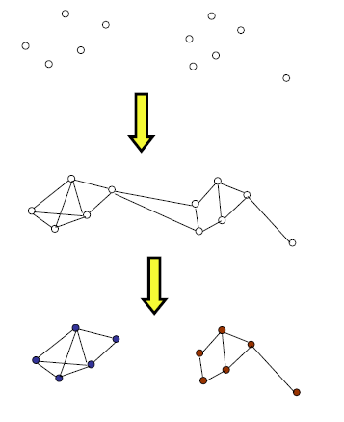
First-graph representation of data
(largely, application dependent)
Then-graph partitioning
In this talk–mainly how to find a good partitioning of a given graph using spectral properties of that graph

Slide 19
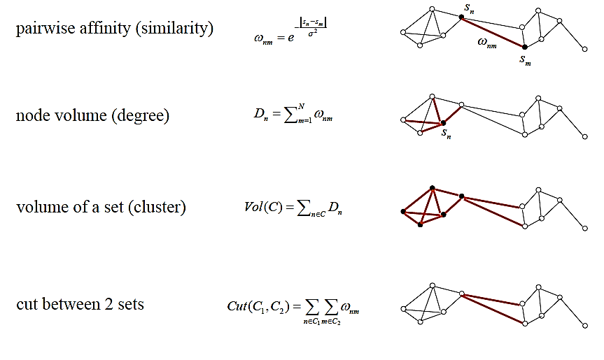
Graph Terminology

Slide 20
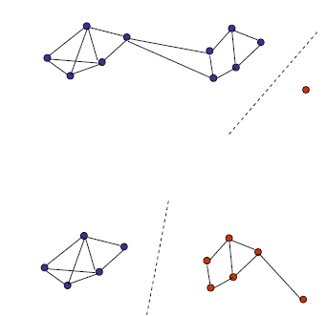
Graph Cuts
Minimal bipartition cut
Minimal bipartition normalized cut
Problem: finding an optimal graph (normalized) cut is NP-hard
Approximation: spectral graph partitioning

Slide 21
Algorithms
Spectral clustering -overview
Main difference between algorithms is the definition of A=func(W)

Slide 22
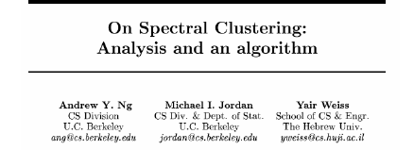

Slide 23
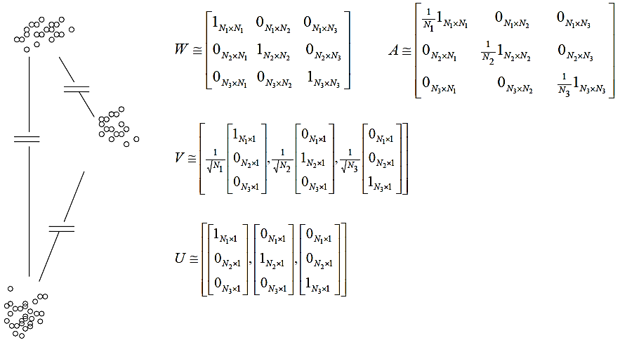
The “Ideal” case
Eigenvectors are orthogonal
Clustering rows of U correspond to clustering points in the ‘feature’ space

Slide 24
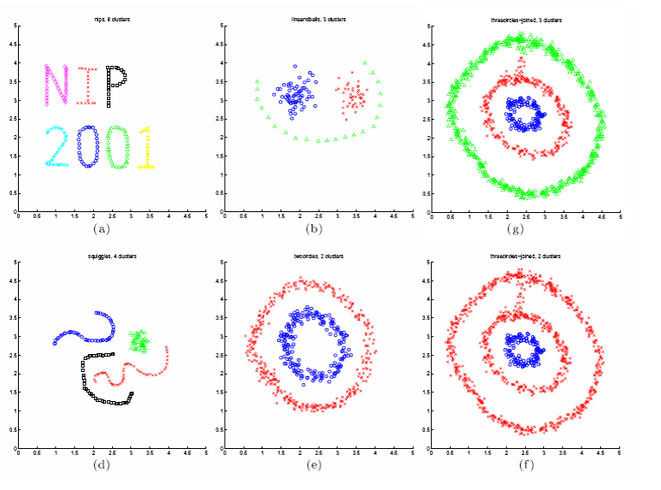

Slide 25
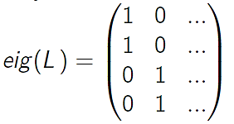
The perturbation theory explanation
Ideal case: between-cluster similarities are exactly zero.
Then:
For L: all points of the same cluster are mapped on the identical point in $R^{k}$
Then spectral clustering finds the ideal solution.
The stability of eigenvectors of a matrix is determined by the eigengap

Slide 26
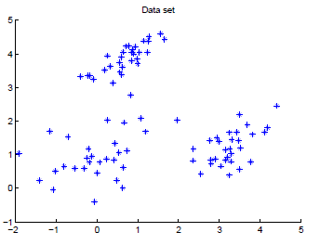
Toy example with three clusters
Data set in $R^{2}$
similarity function with σ= 0.5
Use completely connected similarity graph
Want to look at clusterings for k = 2,...,5 clusters

Slide 27
example with three clusters
Each eigenvector is interpreted as a function on the data points:
Xj → j-th coordinate of the eigenvectors.
This mapping is plotted in a color code:

Slide 28
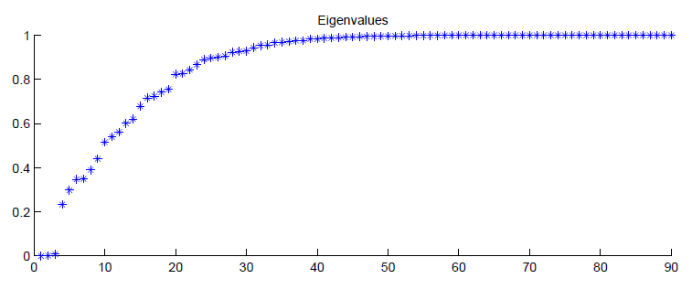
example with three clusters
The eigenvalues (plotted i vs. λi ):

Slide 29
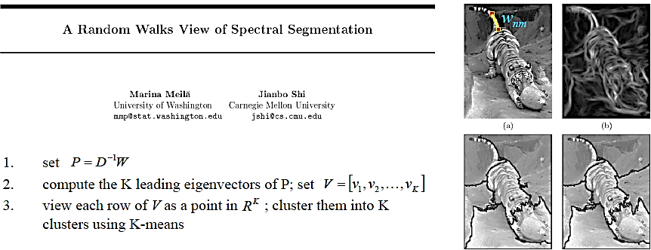

Slide 32
Kinect

Slide 33
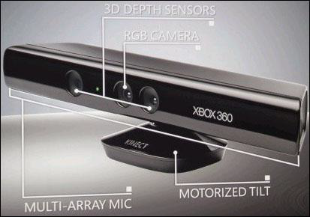
Kinect Introduction

Slide 34
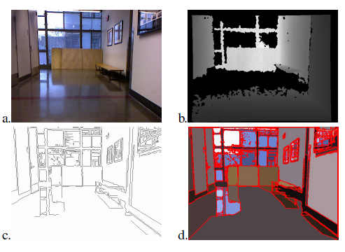
Kinect-based Segmentation

Slide 35
Thank You
Questions?

