Slide 1
Robust Multiple Car Tracking
with occlusion reasoning
Koller, Weber, Malik
University of California, Berkeley
Presenter: Mohammad Shirazi
Advisor : Dr. Morris
University of Nevada, Las Vegas

Slide 2
Outline
Introduction
Motion Segmentation
The Affine Motion Model
Contour Extraction & Shape Estimation
Recursive Shape Estimation & Motion Estimation
Occlusion Reasoning
Results with real world Traffic Scenes
Conclusion

Slide 3
Introduction
Idea of vision-based vehicle tracking
Stationary cameras mounted at a location high above the road
Having system to automatically generate traffic information like vehicle count, speed, lane change and so fourth
Advantageous
Flexibility
Easy Installation
Cheap

Slide 4
Introduction
Vision-based tracking is always challenging
Lights, Shadow, Noise
Objects do not have same characteristic over different frames
Different situation might happen like occlusion
There is need for a simple and fast but robust tracker
Perform tracking without any priori knowledge about the shape of moving object

Slide 5
Introduction
Tracking Examples
https://www.youtube.com/watch?v=tbHWvPWhVh8
https://www.youtube.com/watch?v=SfGAnbyjoGw
https://www.youtube.com/watch?v=1Hpljc10gVM&NR=1&feature=fvwp

Slide 6
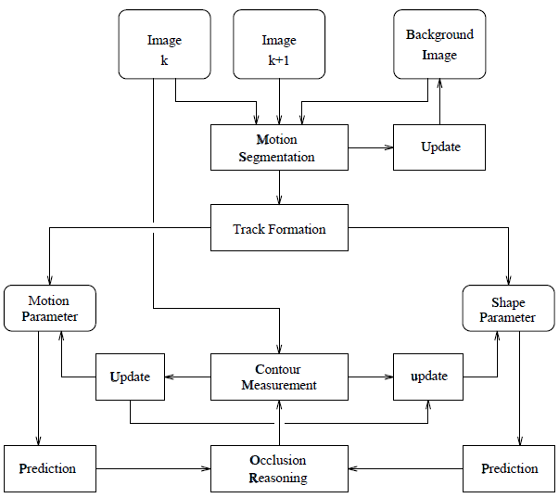
Figure 1: A block scheme of the complete tracker

Slide 7
Motion Segmentation
Differencing between each new frame and an estimate of the stationary background
Background evolves over time
lighting conditions change
Background is updated via the update equation
$B_{t+1}$= $B_{t}+ {(α}_{1}(1−M_{t}$)+$α_{2}M_{t}$) $D_{t}$
$B_{t}$ is estimate of the background model, $α_{1}$ and $α_{2}$represent rate of change of background
$D_{t}$ is difference between frame and background
$M_{t}$ is binary moving objects hypothesis mask
Background is updated in kalman filter formalism

Slide 8
Motion Segmentation
The hypothesis mask, $M_{t}$ identify moving objects
Linear filters are used to increase the accuracy of the decision process
Three filters are used for each frame (Gaussian, Gaussian derivative along the horizontal and vertical)

Slide 9
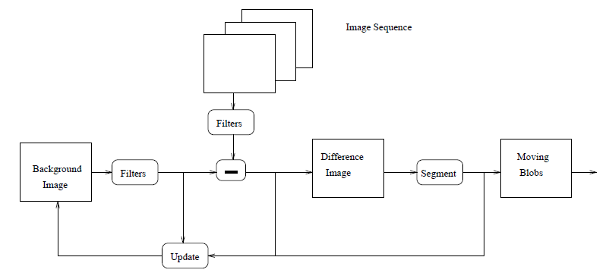
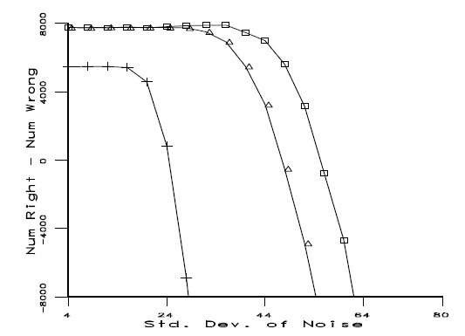
Figure 3: Plot of the number of pixels correctly labeled minus incorrectly labeled
as function of added noise
Figure 2: block diagram of segmentation and background update procedure

Slide 10
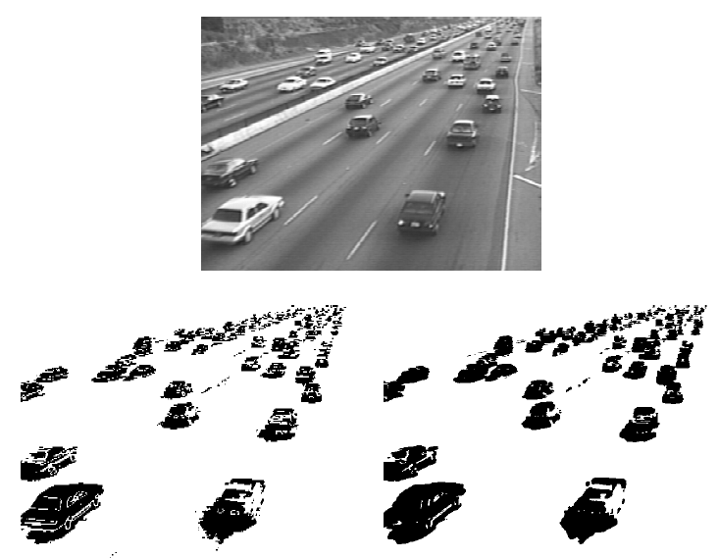
Figure 4: Original image (upper image) and motion hypothesis images produced by
an intensity differencing method (left) and filtered differencing method (right)

Slide 11
The Affine Motion Model
Apparent image motion at location $x$ is approximated by following:
$x_{m}$ is center of the patch
$u_{0}$ the displacement of $x_{m}$
$A$ is rotation and scaling matrix
Rotation component is very small and we end up with scaling factor $s$

Slide 12
Contour Extraction & Shape Estimation
Contour Description
Thresholding the spatial image gradient
Initial object description
Finding a convex polygon enclosing all the sample points of the location that passed test for grayvalue boundaries and motion areas
Snakes (Spline approximation to contours)
Splines are defined by control points ( shape estimation becomes quite easy)
Cubic spline approximation of the extracted convex polygon
Using 12 control points to approximate the polygon contour by 12 segments (spans)

Slide 13
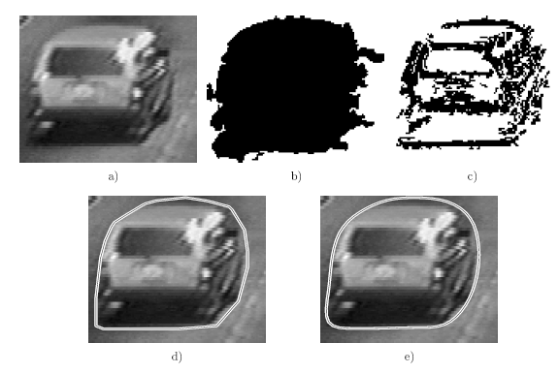
Figure 5: a) An image section with moving car b) the moving object mask
c) image location with well defined spatial gradient and temporal derivative
d) the convex polygon e) final description by cubic spline segments

Slide 14
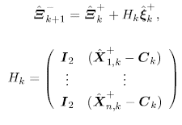
Recursive Shape and Motion Estimation
Following Vectors are defined
$Ξ=(X_{1},Y_{1},…,X_{n},Y_{n})$
$ξ=(u,v,s)$
They represent state vectors of vertices and state vectors of affine motions
We have (1)
With $i ε \left\{1,…,n\right\} , C_{k}=\left(C_{x,k},C_{y,k}\right)$denotes center of all n control vertices.
We can put equation (1) into matrix form

Slide 15
Recursive Shape and Motion Estimation
Affine motion parameters $ξ=(u,s)$
We simply have
$Q_{k}:q_{k}\sim 𝒩(0,Q_{k}$)
Measurement vector
$R_{Ξ,k}:$ $v_{k}\sim 𝒩(0,R_{Ξ,k}$)
Kalman equations are used to update states with related covariance matrices

Slide 16
Recursive Shape and Motion Estimation
Initialization
Initial values for $u_{0}$ is derived by discrete time derivatives of the object center locations
$u_{0}=C_{k}−C_{k−1} ,s_{k}=0$
data association between frames is found by largest overlapping region of two patches (simple nearest neighborhood)

Slide 17
Recursive Shape and Motion Estimation
Tracking Procedure
Look for new blob labels that do not significantly overlap with the contour of an object already to be tracked
Analyze all new found labels
Move a object after the second appearance from the initialization list into the tracking list
Analyze all objects in the tracking list by handling different occlusion cases

Slide 18
Occlusion Reasoning
Any contour distortion will generate an artificial shifts
Occlusion reasoning step
we have to analyze the objects in an order according to their depth (distance to the camera)
The depth ordered objects define the order in which objects are able to occlude each other

Slide 19
Occlusion Reasoning
We assume that the z-axis of the camera is parallel to ground plane, $y_{c}=−h$
$h$ is the height at which the camera is mounted above the road
Image coordinates for an object moving on the ground
${(x^{′},y^{′})}^{T}= {(f\frac{x_{c}}{z_{c}}\text{, }f\frac{y_{c}}{z_{c}})}^{T}={(f\frac{x_{c}}{z_{c}}\text{, }−f\frac{h}{z_{c}})}^{T}$
Camera has an inclination angel $α$ toward the ground plane
Camera coordinates${x_{c}= (x_{c},y_{c},z_{c})}^{T}$
World coordinates ${x_{w}= (x_{w},y_{w},z_{w})}^{T}$

Slide 20
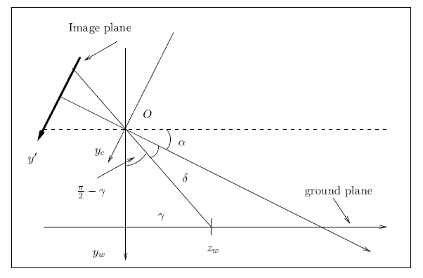
Ground plane is $x_{w}−z_{w}$ plane
Y component of the image coordinate
$y^{′}= f\frac{y_{c}}{z_{c}}=ftan δ$
$δ= γ−α$with $γ=\arctan{\frac{h}{z_{w}}}$
$y^{′}=ftan δ=ftan$($\arctan{\frac{h}{z_{w}}}$ $−α$)
So, depth ordering of the object can be obtained by simply considering their y coordinate in the image

Slide 21
Occlusion Reasoning
Occlusion reasoning procedure
Sort the objects in the tracking list by their y coordinate of the center of the predicted contour
Look for overlapping regions of the predicted contours and decide in the case of an overlapping region-according to the y-position –if the object is occluded or if the object occludes another object
Analyze all objects in the tracking list by handling the different occlusion cases

Slide 22
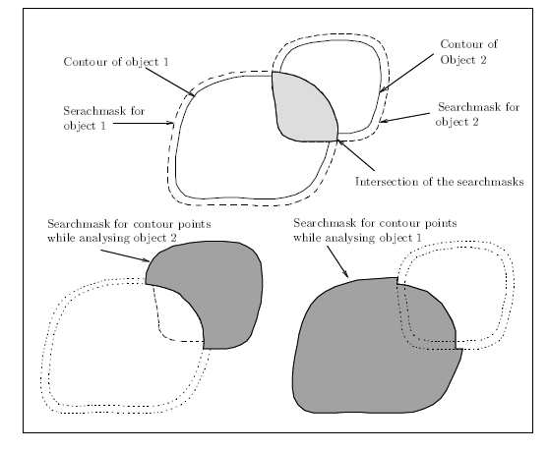
If object under investigation occludes another object, we remove the image area associated of the other object in the contour estimation task but keep the overlapping part; in the case of getting occluded, we remove the area associated of the other object and used the predicted contour as new measurement to update the motion and shape parameters

Slide 23
Results with real world Traffic Scenes
Performing experiments on two image sequences
$σ=1$ for first derivative of Gaussian for convolution; Thresholding for the spatial and temporal derivatives inside an image patch $τ_{g}=2$ and $τ_{t}=20$
For the affine motion estimation we set:

Slide 24
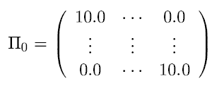
Results with real world Traffic Scenes
For shape estimation, we assume independent measurement noise with $v=0.4$ pixel for each vertex and a start covariance with
As process noise for each vertex we set w=0.001, number of control vertices is always 12
A sequence of 84 frames recorded from an overpass of divided 4 lane freeway

Slide 25
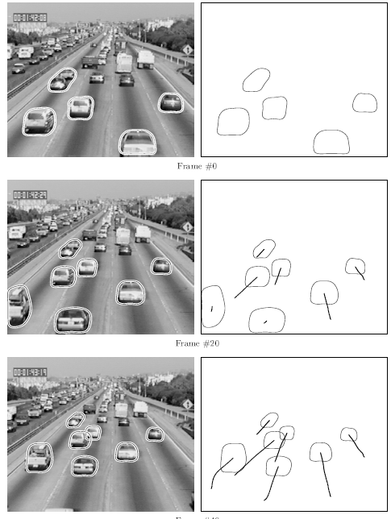

Slide 26
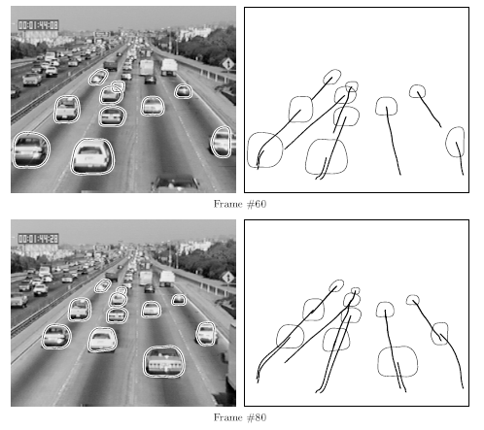

Slide 27
Conclusion
Machine vision based system for robust detection and tracking of multiple vehicles was designed
Reliable trajectories of vehicles are obtained by considering an occlusion reasoning
Convex contours are used to describe objects (snakes)
Tracker is based on two simple kalman filter for estimating the affine motion parameters and the control points of the closed spline contour

Slide 28
Thank You
QUESTIONS?

Slide 29
Introduction
Multi target tracking requires data association
Three approaches data association
Heuristic
Simple rule or priori knowledge
Probabilistic non-Bayesian
Hypothesis testing or likelihood function
Probabilistic Bayesian
Conditional probabilities

