Slide 1
EE292 Fall2012
Awesome Project:
Keypad Reader
Brendan Morris
12/06/2012

Slide 2
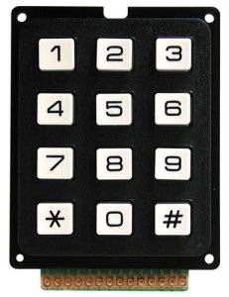
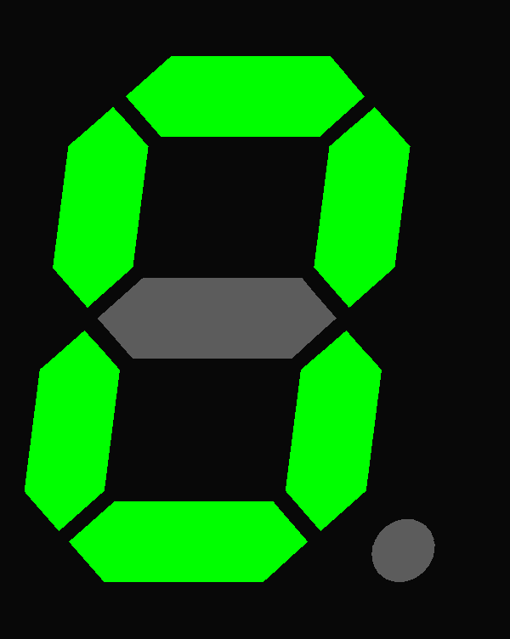
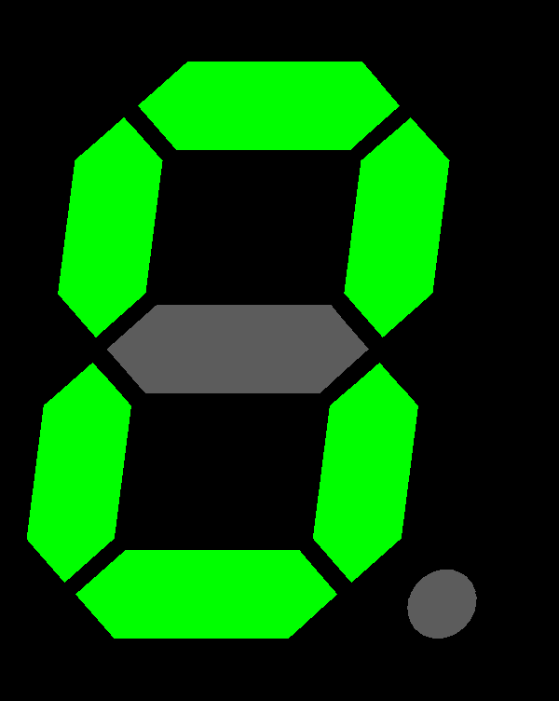
Abstract/Goal/Motivation/Introduction
Accept user input from a 9 digit keypad
  This should be non-blocking to allow the processor to do other calculations
Output key is illuminated on an 7-segment LED

Slide 3
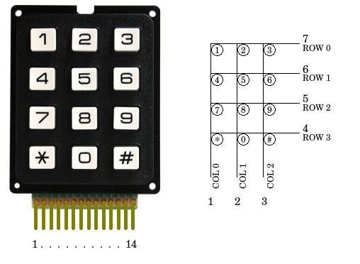
Description
Usage: A user presses on a single keypad button and the button that is pressed gets displayed on the LED array
Keypad numbering
Keypad is interrupt driven
  Must set keypad to pulse operation and have the AND enabled interrupt button active
Number of the pressed key is written to the 7-segment display

Slide 4
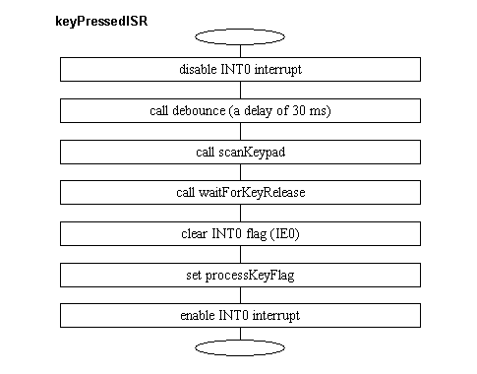
Implementation
Hardware
  External Keypad
  7-segment LED
Enable/initialize external interrupt
Main program waits for key press
On key press
  Run external interrupt service routine (ISR)
    Poll keypad to find which key was pressed
    Output number of key pressed to illuminate 7-segment display
Issues/subtleties
  Still have to poll keys even under interrupt (software decoding)
  Must be sure to enable/disable interrupts during ISR
Software design

Slide 5
Results Demo
<show a movie here of your project in action>
http://youtu.be/bi9vrCkJWHg

