Slide 1
EE360: Signals and System I
Fourier Series Motivation

Slide 2
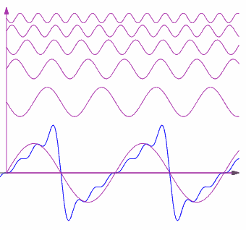
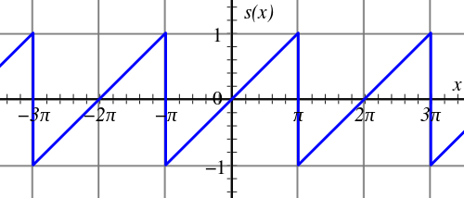
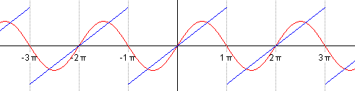
Sawtooth Example

Slide 3
Big Idea: Transform Analysis
Make use of properties of LTI system to simplify analysis
Represent signals as a linear combination of basic signals with two properties
  Simple response: easy to characterize LTI system response to basic signal
  Representation power: the set of basic signals can be use to construct a broad/useful class of signals

Slide 4
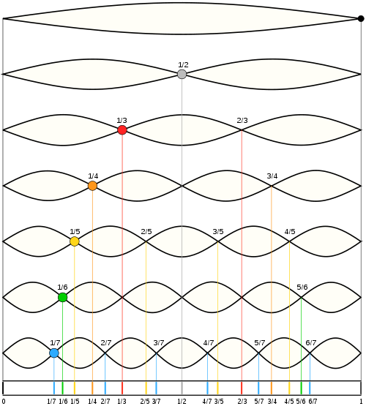
Normal Modes of Vibrating String
Consider plucking a string
Dividing the string length into integer divisions results in harmonics
  The frequency of each harmonic is an integer multiple of a “fundamental frequency”
  Also known as the normal modes
It was realized that the vertical deflection at any point on the string at a given time was a linear combination of these normal modes
  Any string deflection could be built out of a linear combination of “modes”

Slide 5
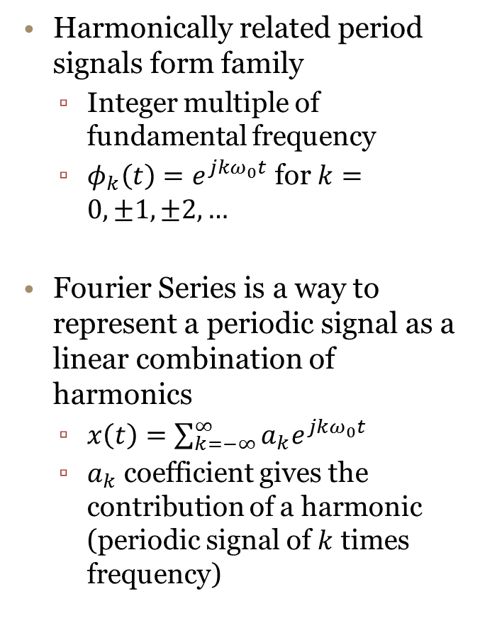
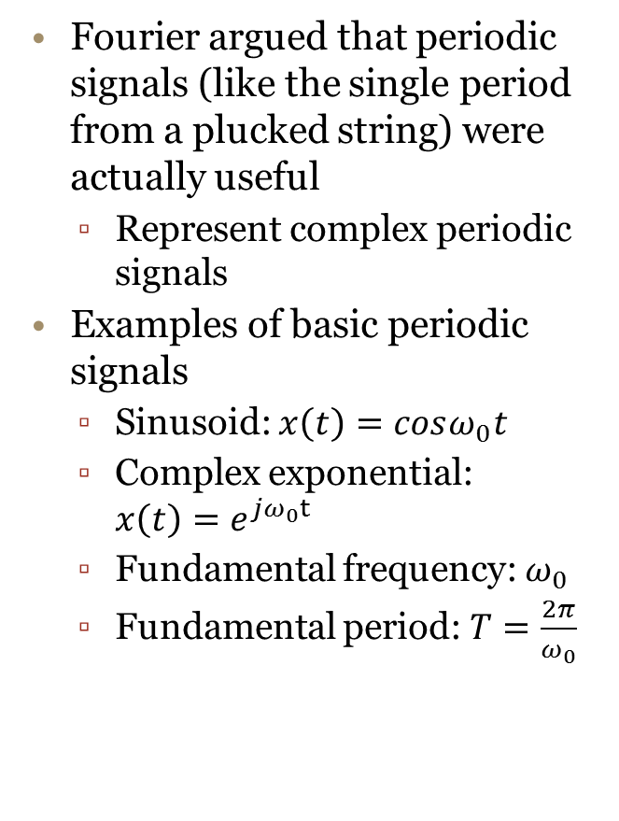
Fourier Series
Fourier argued that periodic signals (like the single period from a plucked string) were actually useful
  Represent complex periodic signals
Examples of basic periodic signals
  Sinusoid: $x\left(t\right)=cosω_{0}t$
  Complex exponential: $x\left(t\right)=e^{jω_{0}t}$
  Fundamental frequency: $ω_{0}$
  Fundamental period: $T=\frac{2π}{ω_{0}}$
Harmonically related period signals form family
  Integer multiple of fundamental frequency
  ${φ_{k}\left(t\right)=e}^{jkω_{0}t}$ for $k=0,±1,±2,…$
Fourier Series is a way to represent a periodic signal as a linear combination of harmonics
  $x\left(t\right)=\sum_{k=−∞}^{∞}{a_{k}e^{jkω_{0}t}}$
  $a_{k}$ coefficient gives the contribution of a harmonic (periodic signal of $k$ times frequency)

Slide 6
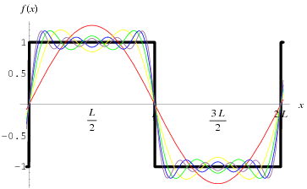
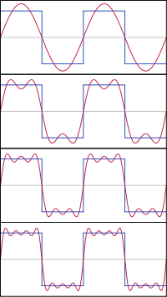
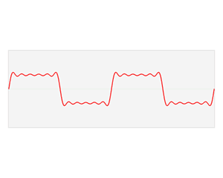
Square Wave Example
Better approximation of square wave with more coefficients
Aligned approximations
Animation of FS

Slide 7
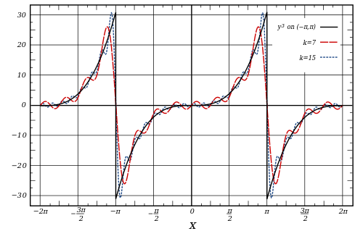
Arbitrary Examples
Interactive examples

